Slide 1
Improving Deep Learning Training and Inference with Dynamic Hyperparameter Optimization
Angela Jiang
Thesis committee
Greg Ganger (Chair)
Dave Andersen
Michael Kaminsky
Michael Kozuch
Padmanabhan Pillai
Rahul Sukthankar

Slide 2
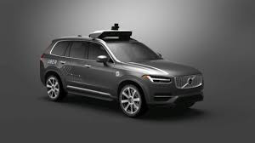
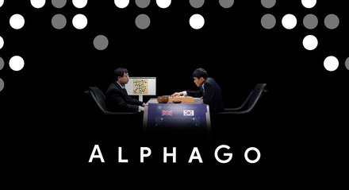

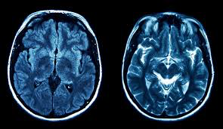
Introduction
DEEP LEARNING EMPOWERS EMERGING APPLICATIONS
Improve efficiency and robustness
of deep learning systems
Notes:
Over the past decade, advances in deep learning have revolutionized fields like CV and NLP, empowering emerging applications such as autonomous driving and medical imaging. There are still many challenges to overcome in realizing the potential of deep learning in production systems. In this talk, we’re going to address two of them: namely the efficiency of deep learning systems, and their robustness to changes in their computing environment
** Potentially skip **
** Add DNN introduction **

Slide 3

Introduction
TRAINING AND DEPLOYING DNNS REQUIRES TUNING
Notes:
To improve the efficiency and robustness of deep learning systems, we’re going to focus our attention of the various hyperparameters that must be optimized in order to properly train and deploy deep learning models

Slide 4
Introduction
TRAINING AND DEPLOYING DNNS REQUIRES TUNING
Learning rate
Momentum
Dropout
Architecture
Optimizer
Training time
Parameters tuned
once and before training
Notes:
Typical hyperparameters that may come to mind are like the learning rate and momentum. But there are also countless parameters that must be tuned for any setup, such as the architecture of the model being trained, or the training time budget. Many of these are implicitly tuned. But notably the way it’s done currently is that almost all hyperparameters are only tuned once, and tuned before training starts.

Slide 5
Introduction
CONDITIONS CHANGE OVER TIME
During training
Magnitude of gradients
Magnitude of losses
Training loss
Test loss
Training error
Test error
…
During deployment
Hardware
Software framework
Concurrent applications
Latency SLAs
Accuracy SLAs
…
Notes:
However, the computing conditions that dictate the best optimization fluctuate over time. For instance, over the course of training….

Slide 6
Introduction
CONDITIONS CHANGE OVER TIME
During training
Magnitude of gradients
Magnitude of losses
Training loss
Test loss
Training error
Test error
…
During deployment
Hardware
Software framework
Concurrent applications
Latency SLAs
Accuracy SLAs
…
NO SINGLE BEST VALUE
Notes:
However, the computing conditions that dictate the best optimization fluctuate over time. For instance, over the course of traing….

Slide 7
Introduction
EXAMPLE: LEARNING RATE IS ADAPTIVELY TUNED
Fixed learning rate
Manual learning rate decay
Automated learning rate decay with optimizers
Adagrad
RMSProp
Adam
Notes:
This is evidenced by the learning rate, a hyperparameter that greatly impacts the speed of training and the resulting model accuracy. Almost no one in practice trains dnns with a fixed learning rate. Instead, they either manually decay it over training, or use an optimizer that automatically decays it for you, for instance, based on the magnitude of the recent gradients as in RMSprop
Adagrad: We perform larger updates for infrequent parameters and smaller updates for frequent parameters.
RMSProp: Normalizes the gradient using the magnitude of the recent gradients

Slide 8
Introduction
THESIS STATEMENT
Using runtime information to dynamically adapt hyperparameters that are traditionally static, such as emphasis on individual training examples and the weights updated during transfer learning, can increase the accuracy and speed of deep learning training and inference.
Notes:
We want to apply this kind of adaptive hyperparameter tuning more broadly. In this work, we aim to provide evidence that supports the following thesis statement <loooong paus>
** read it precisely or put in color the parts read **
** point on what you’re actually optimizing **

Slide 9
Introduction
THESIS STATEMENT
Using runtime information to dynamically adapt hyperparameters that are traditionally static, such as emphasis on individual training examples and the weights updated during transfer learning, can increase the accuracy and speed of deep learning training and inference.
Notes:
We want to apply this kind of adaptive hyperparameter tuning more broadly. In this work, we aim to provide evidence that supports the following thesis statement <loooong paus>
** read it precisely or put in color the parts read **
** point on what you’re actually optimizing **

Slide 10
Introduction
THESIS STATEMENT
Using runtime information to dynamically adapt hyperparameters that are traditionally static, such as emphasis on individual training examples and the weights updated during transfer learning, can increase the accuracy and speed of deep learning training and inference.
Notes:
We want to apply this kind of adaptive hyperparameter tuning more broadly. In this work, we aim to provide evidence that supports the following thesis statement <loooong paus>
** read it precisely or put in color the parts read **
** point on what you’re actually optimizing **

Slide 11
Introduction
THESIS STATEMENT
Using runtime information to dynamically adapt hyperparameters that are traditionally static, such as emphasis on individual training examples and the weights updated during transfer learning, can increase the accuracy and speed of deep learning training and inference.
Notes:
We want to apply this kind of adaptive hyperparameter tuning more broadly. In this work, we aim to provide evidence that supports the following thesis statement <loooong paus>
** read it precisely or put in color the parts read **
** point on what you’re actually optimizing **

Slide 12
Introduction
CASE STUDIES
Selective-Backprop [Under submission] Adapt-SB [New]
Adapting which examples we train on
Mainstream [USENIX ATC 2018]
Adapting stem-sharing for DNN inference
Notes:
** Better transition between thesis statement and case studies **

Slide 13
Introduction
CASE STUDIES
Selective-Backprop [Under submission] Adapt-SB [New]
Adapting which examples we train on
Mainstream [USENIX ATC 2018]
Adapting stem-sharing for DNN inference

Slide 14
SelectiveBackprop
DNN TRAINING ANALYZES MANY EXAMPLES
Notes:
Since we’re going to focus on training DNNs, I’ll give some quick background on how deep learning training works and what makes it so slow. The way these models work, is you show them examples of what it's supposed to be predicting. For instance, if you want your DNN to be able to recognize pedastrians, you need to show it sometimes hundres of millions of examples of different pedestrians over and over and over again. You can imagine, that this takes a lot of time and computing resources.

Slide 15
SelectiveBackprop
DATASETS CAN BE TOO LARGE TO TRAIN ON EVERYTHING
ImageNet dataset: 15 million examples
OpenImages dataset: 9 million examples
Production datasets are often much larger
Google JFT dataset: 300 million examples
amazon click-through data
Uber autonomous vehicle training video
Notes:
In fact, these datasets are sometimes so large that we cannot train on all the data. This might be in contrast with what you’ve heard, which is that more labeled data is always better. But in practice, we often have more examples than we have time or resources to train with. For instance, you’d never expect to able to train though all of Google’s click through data

Slide 16
SelectiveBackprop
DNN TRAINING ANALYZES AN EXAMPLE MANY TIMES
Epoch 1
Epoch 2
Notes:
Now, let’s look at for each of these millions of examples what’s happening

Slide 17
SelectiveBackprop
DNN TRAINING ANALYZES AN EXAMPLE MANY TIMES
Epoch 2
Notes:
** Pointer or animate a walkthrough, change forward pass / backward pass to be actions, forward(s) pass **
Can we avoid doing the backwards pass so often? What if there are examples that are more surprinsing that teach the ntwork more than others?
Backward pass is when the network is learning, so you can learn more from surprising examples
Standard thing is to train on everything. But like anything there's skew. There's some examples that are more useful to train on everything! Spend more time learning from the hard examples because they're harder. Focus on more othe attenton oh ard attnetion, not all the attention
The way we're gonna reduce the backwards pass, by skipping the backwards pass by the thing that's easy
Backwards pass is slow -> cosine similarity
Where are you gonna find the opportunity is to recognize that they're not all qually useful (if all math problems are 2+2, then you don't want to remove all of them) if you're working on flashcards, you start skipping the flashcards
Make this slide into a LOOP. there are many epochs, send all the images through in many epochs, standard training is n epochs so we're going to see N million images. this is where a lot of time is spent. (so you get the iterative feel and how big it is). then you understand why backprops
why do you start over, debugging the model, trying to improve the accuracy. reducing the time from 80 hours!@ to 40 hours is really signficant, otherwise you can't try again. The best you can hope for is a factor of 2. Is it significant, well it is because it's a huge debugging cycle. Less compelling if it's 1 hour
say "for all experiments we focus on image classification"
SMART BUT IGNORANT

Slide 18
SelectiveBackprop
SELECTIVE-BACKPROP TARGETS SLOWEST PART OF TRAINING
Notes:
** In aggregate over the course of training run **
Here I’m going to show you the time it takes to train a DNN using a dataset called SVHN to a particular target error. I won’t go through all the details, but I want to draw your attention to 2 main things.
is that training takes a long time. In this case, the y-axis is in hours and it goes to 90. And this is for a relatively simple training task. This is why reducing training time is so important.
Next, we’re doing the same number of forwards and backwards passes during training, one for each batch of examples. But you’ll see that the time spent in the backwards pass, the blue, is twice as long in than th etime spent in forwards, the green
That’s why with SelectiveBackprop, we target reducing the time spent in the backwards pass. In this case, we were able to achieve the same error rate, with much less time. And we do this, but being selective about doing fewer backwards passes.
ADD:
decrease time to error
maximize accuracy you get as a function of the amount of time to train
I'm showing you this result in terms of a runtime!!
"I'm not going to tell you all the details of this...but this is the result of a particular model being trained. Details to come. WHat i want you do know bout it. before we do something it looks like this, after we do something it looks like this

Slide 19
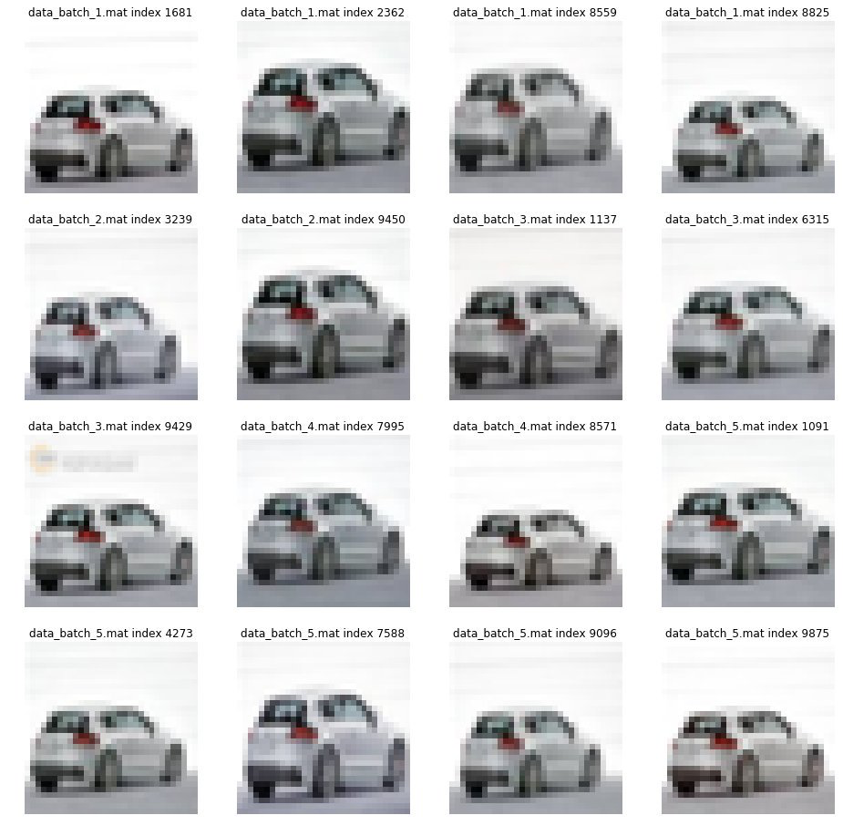
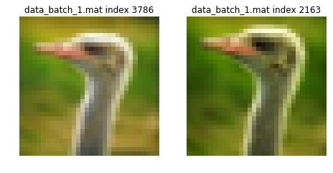
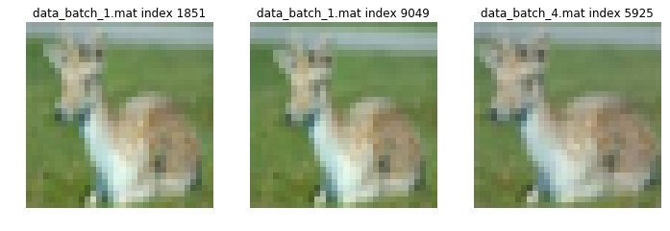
SelectiveBackprop
NOT ALL EXAMPLES ARE EQUALLY USEFUL
Notes:
The reason that we can skip some backwards passes and get the same result, is that not all examples are equally useful. In any dataset, we’ll find some skew. For instance, these are all example images from the same dataset. If you treat all examples uniformly, you’ll have trained on another version of this same car 16 times more than other examples. So pretty early on in training, it’s likely that these examples are no longer useful to train on
Skew also doesn’t just result from redundancy in the dataset. In general, some examples might just be more useful in training, than others

Slide 20
SelectiveBackprop
Which examples are challenging?
Notes:
Intuitively, in SelectiveBackprop, we’d like to prioritize examples that are challenging to us, that is examples that are surprising to the network. It the network thinks it’s one thing, but it’s actually another, then that example probably has a lot to teach us.
So a key question that SB proposes is what examples are challenging? This is our first “hyperparameter” that we will optimize dynamically. Because what we see is that the examples that are most challenging to our network, fluctuate over the course of training

Slide 21
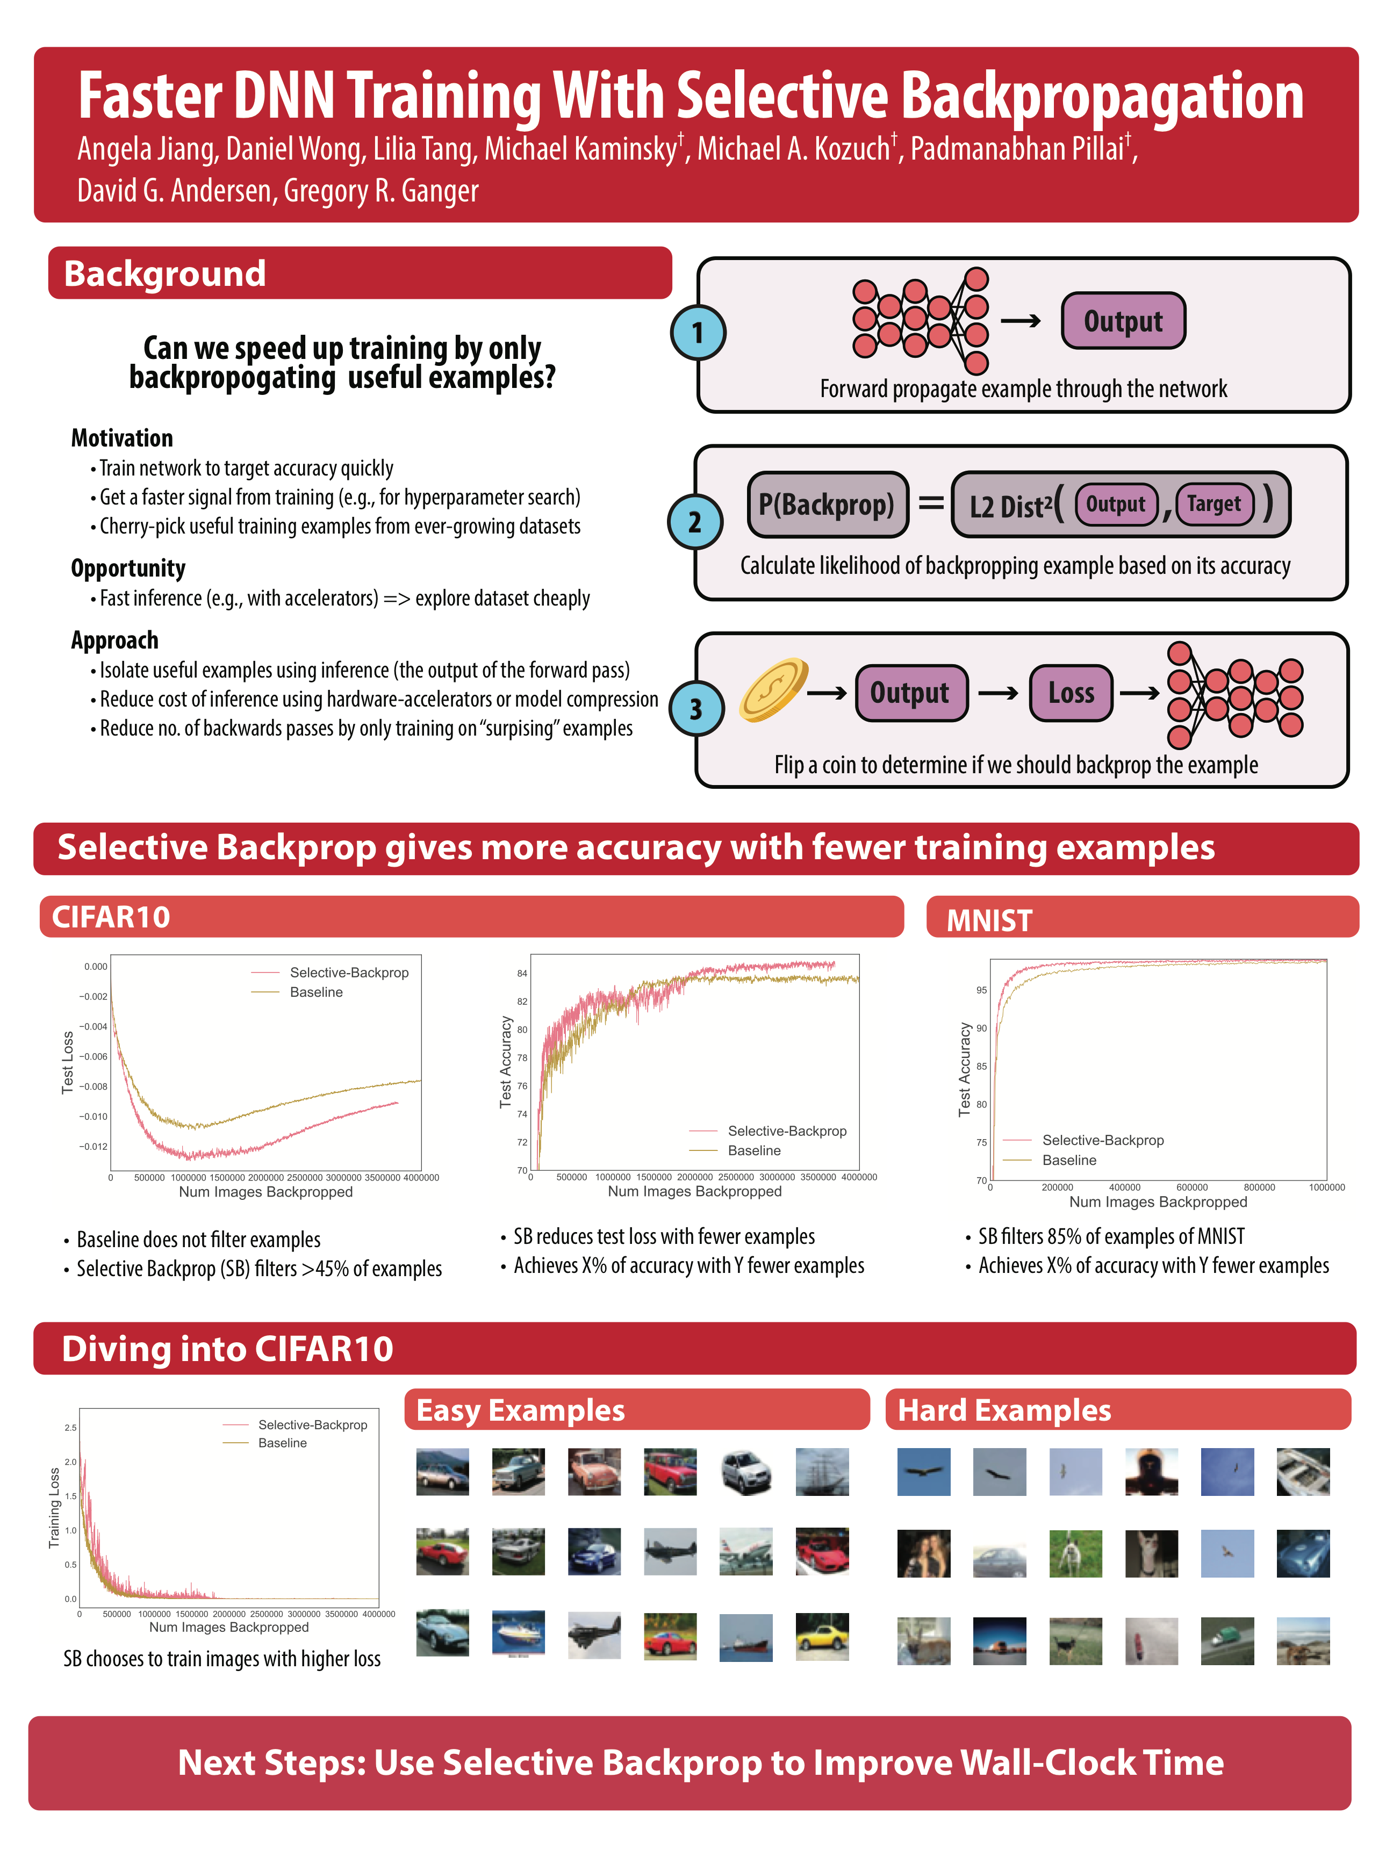
SelectiveBackprop
PRIORITIZE EXAMPLES WITH HIGH LOSS
Examples with low loss
Examples with high loss
Notes:
So the intuition is that we’d like to find challenging examples. Technically speaking, we’d like to prioritize examples that have a larger gradient, that is big changes to the network. That’s very expensive to calculate though, so instead, we’ll take the next best thing. We’ll use an example’s loss as a cheap proxy for how big the gradient is. We’ve confirmed experimentally that the two are correlated.
For intuition, I’ve also included some examples here…
Be more explicit about the connection between surprisingness and probability that you select it

Slide 22
SelectiveBackprop
RELATED WORK
Catastrophic forgetting
[Toneva19]
Notes:
Unlike the examples I just showed you, for most examples, it’s relative loss actually fluctuates over the course of training. Other works have shown this phenomenon of “catastrophic forgetting”, which we’ve confirmed experimentally as well.

Slide 23
SelectiveBackprop
RELATED WORK
Catastrophic forgetting
[Toneva19]
History-based importance sampling
[Gao et al., 2015; Johnson & Guestrin, 2018; Loshchilov & Hutter, 2015; Lin et al., 2017, Shrivastava et al., 2016; Schaul et al., 2016.]
Notes:
A key complication of these approaches is that scores of skipped examples become increasingly out-of-date during training; addressing this staleness introduces additional hy- perparameters to navigate the exploration vs. exploitation trade-off. SB simplifies scoring by updating the score of each example with a relatively cheap forward pass. In ad- dition, SB does not require per-example histories and can run in a streaming manner, necessary for extremely large datasets that may be run through just once during training (e.g., click-streams).

Slide 24
SelectiveBackprop
RELATED WORK
Catastrophic forgetting
[Toneva19]
History-based importance sampling
[Gao et al., 2015; Johnson & Guestrin, 2018; Loshchilov & Hutter, 2015; Lin et al., 2017, Shrivastava et al., 2016; Schaul et al., 2016.]
Importance sampling with up-to-date state
[Katharopoulos18]
Notes:
A key contribution of SB is a different sampling strategy and starting steps that converges faster than Katharopoulos & Fleuret (2018), while achieving similar accuracy (Section 5)
We find our difference in performance is due to Kath18’s overly conservative starting condition and different sampling approach: Kath18 uses loss reweighting, samples with replacement, and performs selection within a mini-batch, so the likelihood of an example’s selection is dependent on the composition of the mini-batch.

Slide 25
SelectiveBackprop
SELECTIVE-BACKPROP PRIORITIZES HIGH LOSS EXAMPLES

Slide 26
SelectiveBackprop
SELECTIVE-BACKPROP PRIORITIZES HIGH LOSS EXAMPLES
Notes:
** Add SB filtering box **
** Add more extensive SB, give more warning **
Now the consequence of using an up-to-date state of the network to drive the decision is that for many examples we have a lot of wasted work in calculating the loss. We’ll show in our evaluation that we can still gain speedups, despite this overhead. And we’ll also show at least one optimization to reduce the overhead.

Slide 27
SelectiveBackprop
ATTEMPT #1: DECIDING WITH A HARD THRESHOLD
if loss > threshold: backprop()

Slide 28
SelectiveBackprop
ATTEMPT #2: DECIDING PROBABILISTICALLY WITH LOSS
P(backprop) = normalize(loss, 0, 1)

Slide 29
SelectiveBackprop
SB APPROACH: USE RELATIVE PROBABILISTIC CALCULATION
P(backprop) =
Percentile(loss, recent losses)

Slide 30
SelectiveBackprop
SB APPROACH: USE RELATIVE PROBABILISTIC CALCULATION
P(backprop) =
Percentile(loss, recent losses)^{B}
Lower ^{B} makes SB more selective
Notes:
clamp -> normalize
Maybe talk about the lower bound, we do revisit all the images probabilistically

Slide 31
SelectiveBackprop
SELECTIVE-BACKPROP APPROACH
Forward propagate
example to get loss
Calculate usefulness of
backpropping example
using its loss
Decide probabilistically
if we should backprop
Notes:
Be more explicit about the connection between surprisingness and probability that you select it
We come up with this probability so that images that we have the most to learn from are most likely to be backpropagated
Move this back a couple of slides.
"lets focus on this question of deciding what to backprop"
Next slide would then be stale
CARTOON OF THE INNER LOOP AND THE FILTER. Then be like these are the different kinds of filters that we tried
Flip a coin ->

Slide 32
SelectiveBackprop
STALE-SB REDUCES FORWARD PASSES
StaleSB is a variant of SelectiveBackprop
Forward propagate
example to get loss
every n epochs
Notes:
Be more explicit about the connection between surprisingness and probability that you select it
We come up with this probability so that images that we have the most to learn from are most likely to be backpropagated
Move this back a couple of slides.
"lets focus on this question of deciding what to backprop"
Next slide would then be stale
CARTOON OF THE INNER LOOP AND THE FILTER. Then be like these are the different kinds of filters that we tried
Flip a coin ->

Slide 33
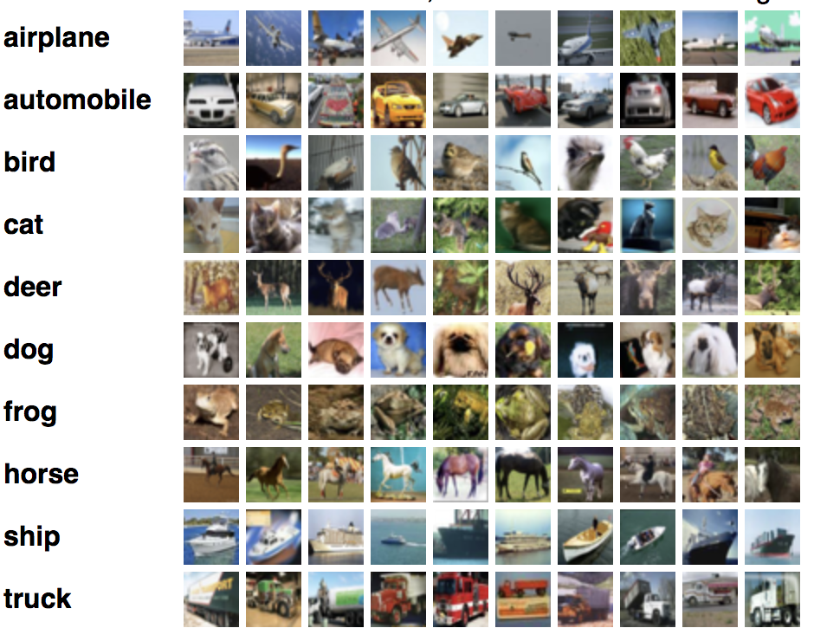
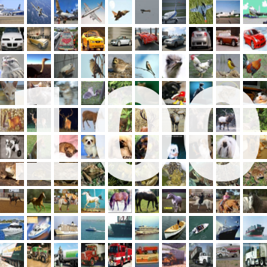
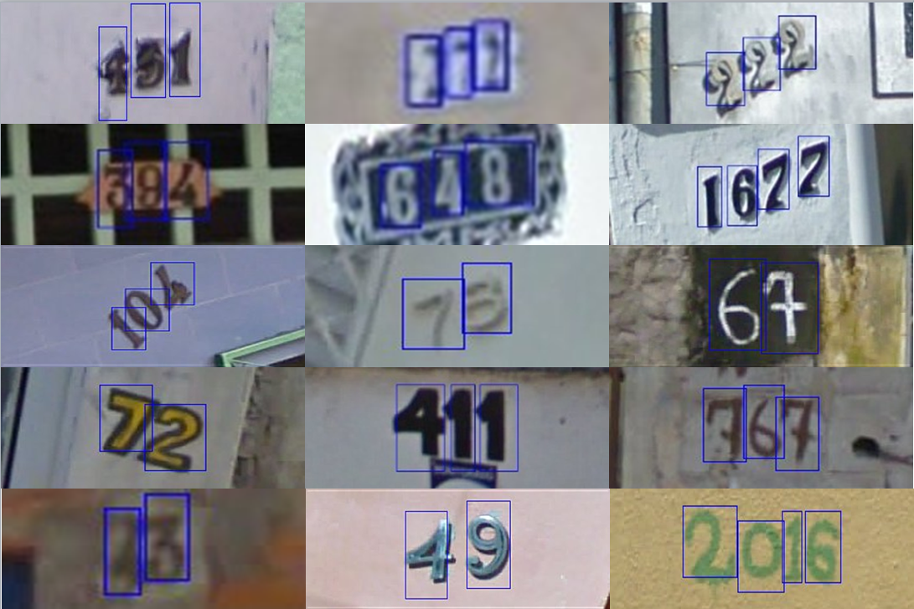
SelectiveBackprop
DATASETS
CIFAR10
CIFAR100
SVHN
60,000 Images
60,000 Images
604,388 Images

Slide 34
SelectiveBackprop
TRAINING CIFAR10 TO 4.14% (1.4X BEST FINAL ERROR)
SB: 1.5X faster
StaleSB: 2X faster
Notes:
SB: 1.5x
StaleSB: 2.0x
2.96%

Slide 35
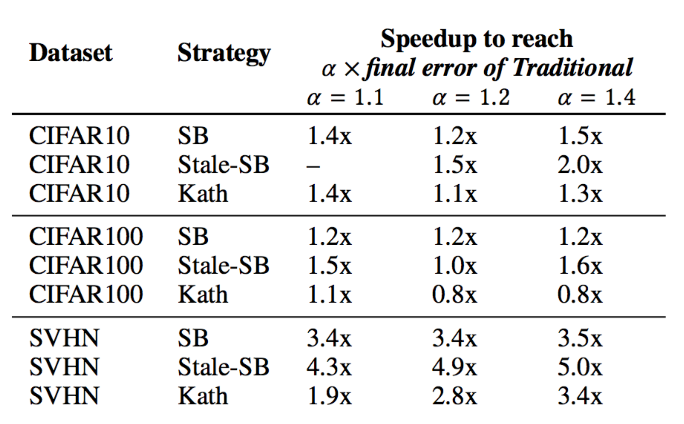
SelectiveBackprop
SB ACCELERATES BY 1.2-3.5X, STALESB ACCELERATES BY 1.6-5X
Notes:
** Fix this **
SB: 1.5x
StaleSB: 2.0x
2.96%
PUT A LINE ACROSS ONE THAT SAYS DOING

Slide 36
SelectiveBackprop
SB ACCELERATES MORE SVHN
60,440
examples / class
6,000
examples / class
600
examples / class
Notes:
** Bring something like this back **
3.4, 1.2, 1.2
4.9, 1.5, 1
2.8, 1.1, 0.8
PUT A LINE ACROSS ONE THAT SAYS DOING

Slide 37
SelectiveBackprop
SELECTIVE-BACKPROP ON CIFAR10 TARGETS HARD EXAMPLES
Target = [0, 1, 0]
27% TC w/ Traditional
65% TC w/ SB
Output = [0.1, 0.3, 0.6]
Target confidence = 0.3
Notes:
** Target confidence 0->100 or 0 -> 1 ** \
20th percentile of target confidences for SB is 55%
Put a vertical line here!
Make the graph larger and put labels on the line
put these before it's pareto
MAYBE CUT
Inner product of the target and output

Slide 38
SelectiveBackprop
SELECTIVE-BACKPROP ON CIFAR10 TARGETS HARD EXAMPLES
3% correct w/ Traditional
29% correct w/ SB
Output = [0.1, 0.3, 0.6]
Notes:
** Target confidence 0->100 or 0 -> 1 ** \
20th percentile of target confidences for SB is 55%
Put a vertical line here!
Make the graph larger and put labels on the line
put these before it's pareto
MAYBE CUT
Inner product of the target and output

Slide 39
SelectiveBackprop
SB IS ROBUST TO MODEST AMOUNTS OF LABEL ERROR
10% Randomized
Notes:
1.4048, 0.360544 = 74.3% fewer backward passes
55% more forwards passes
move the labels ahead
Next move: SelectiveAugment
The studff i was just taling about. imagein that you have a bunch of things that you do to imagines before you pass them trhough the n ewtork, for isntance rotating them and cropping

Slide 40
SelectiveBackprop
SB IS ROBUST TO MODEST AMOUNTS OF LABEL ERROR
20% Randomized
Notes:
1.4048, 0.360544 = 74.3% fewer backward passes
55% more forwards passes
move the labels ahead

Slide 41
SelectiveBackprop
SB IS ONLY ROBUST TO MODEST AMOUNTS OF LABEL ERROR

Slide 42
AdaptSB
Should we prioritize challenging examples?
Notes:
This leads us to wonder…should we always prioritize challenging examples? And what degree should we prioritize them? In SelectiveBackprop, this was held static. For instance, we assumed that an example whos loss was in the 50th percentile of historical examples, should always we backpropped 50% of the time. In AdaptSB, we’ll relax this constraint, and optimize this dynamically

Slide 43
AdaptSB
PRIORITIZATION FUNCTIONS
Probability
Percentile
Notes:
** probability of selection, show where it’s being used with old diagram **
To make this more concrete, I’m going to introduce the concept of a prioritization function. This is a visualization of the transformation used in SelectiveBackprop to calculate priorities.
On the X axis….
Notable, in SB this function is fixed.

Slide 44
AdaptSB
ADAPT PRIORITIZATION TO DATASET AND TRAINING TIME
Probability
Percentile
Notes:
In AdaptSB, we relax this constraint, and allow for arbitrary prioritization functions, and we allow them to shift over time.

Slide 45
AdaptSB
DETERMINE PRIORITY FUNCTION USING HYPERPARAM SEARCH
Probability
Percentile

Slide 46
AdaptSB
ADAPT PRIORITIZATION TO DATASET
In presence of label error, deemphasize challenging examples
Notes:
** Show animation before takeaway **
0.253, 0, 0.905, 1
0.476, 0.223, 1.0, 0.37
0.69, 0.497, 1.0, 0.156

Slide 47
AdaptSB
ADAPT PRIORITIZATION TO TRAINING TIME
In CIFAR10, challenging examples are increasingly useful
Notes:
0.001, 0, 0.616, 1.0
0.0, 0.0, 0.365, 1.0
0.0, 0.0, 0.195, 1.0

Slide 48
AdaptSB
ADAPT PRIORITIZATION TO TRAINING TIME
Prioritize different examples at different times
Notes:
0.001, 0, 0.616, 1.0
0.0, 0.0, 0.365, 1.0
0.0, 0.0, 0.195, 1.0

Slide 49
AdaptSB
ADAPT PRIORITIZATION TO DATASET AND TRAINING TIME

Slide 50
SelectiveBackprop
TAKEAWAYS
✓
SB adapts to which examples are challenging
Trains up to 3.5x faster than standard SGD by prioritizing them
✓
StaleSB further accelerates training
Trains on average 26% faster compared to SB
✓
AdaptSB adapts prioritization to dataset and time
More robust than SB on datasets with label error
www.github.com/angelajiang/SelectiveBackprop

Slide 51
Introduction
CASE STUDIES
Selective-Backprop [Under submission] Adapt-SB [New]
Adapting which examples we train on
Mainstream [USENIX ATC 2018]
Adapting stem-sharing for DNN inference
Notes:
** Tie back to thesis statement **
So we just talked about how dynamic optimization could improve DNN training. Next, let’s switch gears to DNN inference, that is, actually deploying and using the trained model to make predictions. With our system Mainstream, we will improve application performance for inference on the edge.

Slide 52
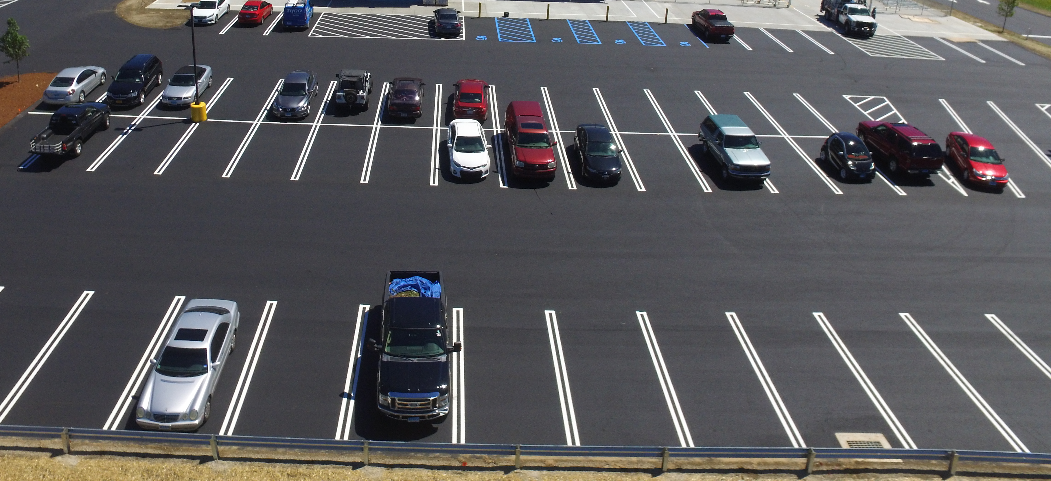
Parking violation monitor
Parking spot finder
Fender-bender monitor
White
Camry
detector
Notes:
Mainstream is a system for automatically training and deploying concurrent video analysis applications. So i’ll start off by giving an example where mainstream can be of some help.
So imagine you have a camera, generating a video stream that’s Analyzing the stream in real time. So you can imagine that there are a lot of ways that you want to use this video feed. Fr instance the mall itself might want to see a parking violation monitor. bBt there might also be other third-party vendors the one independently develop applications as well. So a startup might want to create a parking spot finder app. Insurance companies might want to monitor for fender benders. Maybe the police that day are looking for a particular white Camry and they want to know if it's in this parking lot. To enable a multi-tenant deployment like this still brings about a lot of systems and infrastructure challenges. That's what mainstream is focused on and that's what I'll be talkin about today.
** What is video processing in general, video is the biggest source of data on the internet, in the future, a huge source of data will come from always on edge devices like streaming cameras collecting information trying to make decisions. For example…trying to understand what’s going on in this parking lot …**

Slide 53
Mainstream
CHALLENGE: LIMITED RESOURCES FOR INFERENCE
Datacenter
Edge node
Parking lot
Internet
Notes:
The main infrastructure challenge we face is that often applications must run on whatever compute resources are close to the camera, usually a small, resource constrained edge device. While in theory, you could send the data over the Internet, to a large datacenter for inference
** How is this challenge actually realized. You’re not actually backhauling all this video to the cloud because that’s ltaency, they’re on wires that don’t have the bandwidth, and there’s privacy concerns, users don’t want their data leaving…The computation model for this use case is a set of cameras connected to a Local edge node. In there, you have a modest amount of resourcews. A couple of gpus at most but no where near what you’d have in a datacenter. So the real chanllege of this environment is you have to do these complex semantic interpretation, but you only have this little box. We focus on this case because efficient inference matters a lot. **
** Challenges: resource constrained and need high accuracy **

Slide 54
Mainstream
CHALLENGE: LIMITED RESOURCES FOR INFERENCE
Datacenter
Edge node
Parking lot
MS
Internet
Notes:
This is often prohibitively slow and can lead to privacy issues. So Mainstream will help run applications on the edge

Slide 55
Mainstream
CONTRIBUTIONS
Shares video stream processing of concurrent apps
✓
By sharing redundant computation
Dynamically tunes degree of specialization at runtime
✓
Based on resources available and deployed apps
Notes:
And will provide two main solutions for multi-tentant edge deployments. The first one is that time sharing these concurrent DNN makes inference really slow. While you may be able to run a single DNN on your Edge device in real time, as you add more applications, the DNNs are going to start contending for resources and you're ultimately going to start dropping frames. Instead, in mainstream, we’re going to find computation that's redundant between the applications and then share that computation, thus reducing resource contention and allowing you to process at a faster frame rate. Now this turns out to be a very important optimization to dom if you want your deployment to scale. But in order to actually optimize for this, we have to collaborate between applications.
That brings us to our second challenge, which is that these DNNs are typically tuned in isolation from each other and at development time. And this is really the part that’s important for our discussion of dynamic optimization. In Mainstream, we use dynamic optimization to tune the degree of computation sharing at runtime, because at development time you're not going to know what resources you're going to run on and you won’t know what other applications are going to be running alongside of you. Instead, by doing this dynamically at runtime, we can adapt to the resources available and what applications are running.
These are the two main techniques in this section of the talk. For one, I’ll talk about where does this opportunity for sharing come from. And then I’ll talk about how we optimize for DNN sharing and how we defer that decision to runtime. Ultimately, I'll show how Mainstream performs against some default static approaches. I’ll start with the first one.

Slide 56
Mainstream
EXAMPLE VIDEO ANALYSIS PIPELINE
Edge Node
Decode
Transform
Classify
Post-process
Notes:
Now I’ll show an example video analysis pipeline, running on one edge node. To start with, we have a camera generating frames, for instance at 30 frames per second. Each frame is going to be processed on the edge device through a series of computations. First the frame will be decoded from h.264. We’ll then transform it in some ways -- maybe we'll crop it, maybe will normalize it. And then will actually perform the analysis step. In mainstream we focus on image classification and that's performed using a DNN. Then the output of the DNN will be post-processed in some way.

Slide 57
Mainstream
DNN IS THE PRIMARY COST OF THE PIPELINE
Classify (DNN)
Notes:
Another important thing to note about this pipeline is that the DNN is the primary cost of the pipeline. And not only is it very computationally expensive, but when you add more applications to your deployment. it's very easy to share the initial pre-processing steps for each frame, but the DNN is task specific. So this isn't a very scalable appproach to deploying multiple DNN. And I should say that in mainstream we're not focused on reducing the latency of a single DNN, but making adding applications more scalable. In mainstream, instead we're going to share a large portion of the DNN, and then publish those outputs to smaller task specific DNNS. This is essentially a faster way to run the same 3 DNNs that I showed before. And now if you wanted to add a fourth application, you would just need to add a small task specific DNN to the end and so it's very low marginal cost.

Slide 58
Mainstream
DNN IS THE PRIMARY COST OF THE PIPELINE
Classify (DNN)
Classify (DNN)
Classify (DNN)
Notes:
Another important thing to note about this pipeline is that the DNN is the primary cost of the pipeline. And not only is it very computationally expensive, but when you add more applications to your deployment. it's very easy to share the initial pre-processing steps for each frame, but the DNN is task specific. So this isn't a very scalable approach to deploying multiple DNN. And I should say that in mainstream we're not focused on reducing the latency of a single DNN, but making adding applications more scalable.

Slide 59
Mainstream
IN MAINSTREAM: PARTIAL SHARING OF DNNS
Efficiently run same 3 DNNs
Notes:
In mainstream, instead we're going to share a large portion of the DNN, and then publish those outputs to smaller task specific DNNS. This is essentially a faster way to run the same 3 DNNs that I showed before. And now if you wanted to add a fourth application, you would just need to add a small task specific DNN to the end and so it's very low marginal cost.
** Add intuition why sharing is feasible [90% is figuring out basic colors and patterns]. Why does every application need to be spending their time looking for shapes and colors. The way these DNNs are structured are the their intermediate layers encode *general* features. The intermediate results include general features, and the last layers is where all the specialization and application specific processing happens. We take advantage of this by… **

Slide 60
Mainstream
FINE-TUNING DNN #1
Notes:
Now the question becomes how do we actually find that shared stem, how do we find redundancy between DNNs. To do this, we take advantage of how people train their DNNs. People train their DNNS using something called transfer learning, which I’ll explain next
This is an example DNN. During training time you take weights that are randomized and then you'll feed it a bunch of labeled examples where you know what the answer should be, and slowly move the weights for the state where you get a good result. But this isn't how most people actually train their DNNs, because to train weights from scratch takes a lot of computational resources and also a lot of data which most people don't have for their task. So instead what you do is something called transfer learning where you take a DNN that was already trained for an old task and then fine-tune it for your new task. Here is an old pre-trained network.

Slide 61
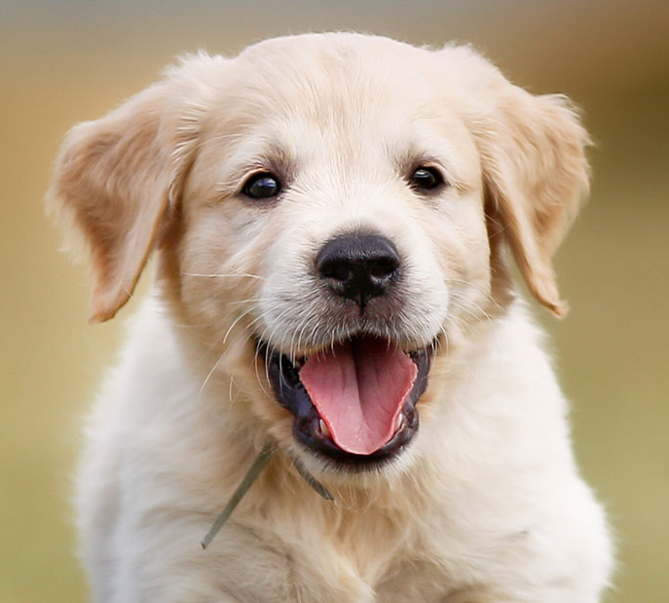
Mainstream
FINE-TUNING DNN #1
Notes:
We take off the old task specific layer, add our new task specific layer, and then when we train we hold a subset of the layers Frozen so that those weights don't change and then we finetune our tasks specific layer. Even though this is the default approach, you don't necessarily have to only fine-tune the last layer. In this case, we’ve held three layers frozen and fine-tuned two.

Slide 62
Mainstream
FINE-TUNING DNN #2
Notes:
DNN/transfer learning background

Slide 63
Mainstream
TWO DNNS AS RUN IN MAINSTREAM
Notes:
So the important thing for Mainstream here is, if you have two networks that were pre-trained off the same base DNN, whatever layers that were held Frozen during training time will be identical, and that’s where you get the redundance from. We actually expect this to happen pretty organically because there's only a handful of Industry standard DNN architectures and an even smaller handful of datasets used to pre train them.
In mainstream we’ll provide the coordination and remember that those layers are identical at run time. When we perform inference every frame is an only run to the shared stem once. Those outputs will be published to task-specific layers and we’ll get the output.

Slide 64
Mainstream
How do we decide what to finetune?
Notes:
That's where the opportunity for sharing comes from and how you take advantage of it. But the question is, how do we actually optimize what amount of sharing we want and what amount of specialization we want. Right now what happens is that is independently determined for each application and it's determined at development time so the application developer when training their task is going to determine how many layers they want to specialize which then dictates how much were allowed to share at runtime. Instead, what we want to do is we want to optimize for this dependent on the resources available and what applications are deployed. This is really the Crux of the Mainstream case study, so next we'll talk about how we perform the DNN sharing and how we defer that optimization at run time, so we can adapt to the resources available and the set of apps.
To optimize for DNN sharing, we first have to understand the trade-offs that come from sharing and specialization, and that's what I'll talk about next.

Slide 65
Mainstream
More sharing =
Higher throughput
More specialization =
Higher per-frame accuracy
Notes:
Here I have two ends of the spectrum, on the left we are sharing as much as possible and only specializing the last layer and on the right we're not sharing anything. On the left we have less computation, there’s less contention and so we're going to get a higher throughput. Whereas on the right during training time we specialize the entire network for a task, which means that our model is going to have the best accuracy possible. The question really becomes, do you want to analyze your video stream at a higher frame rate or do you want to analyze every frame more accurately.
We make that decision based on how those two metrics affect your final application performance. So we’ll talk about how we actually measure application performance.

Slide 66
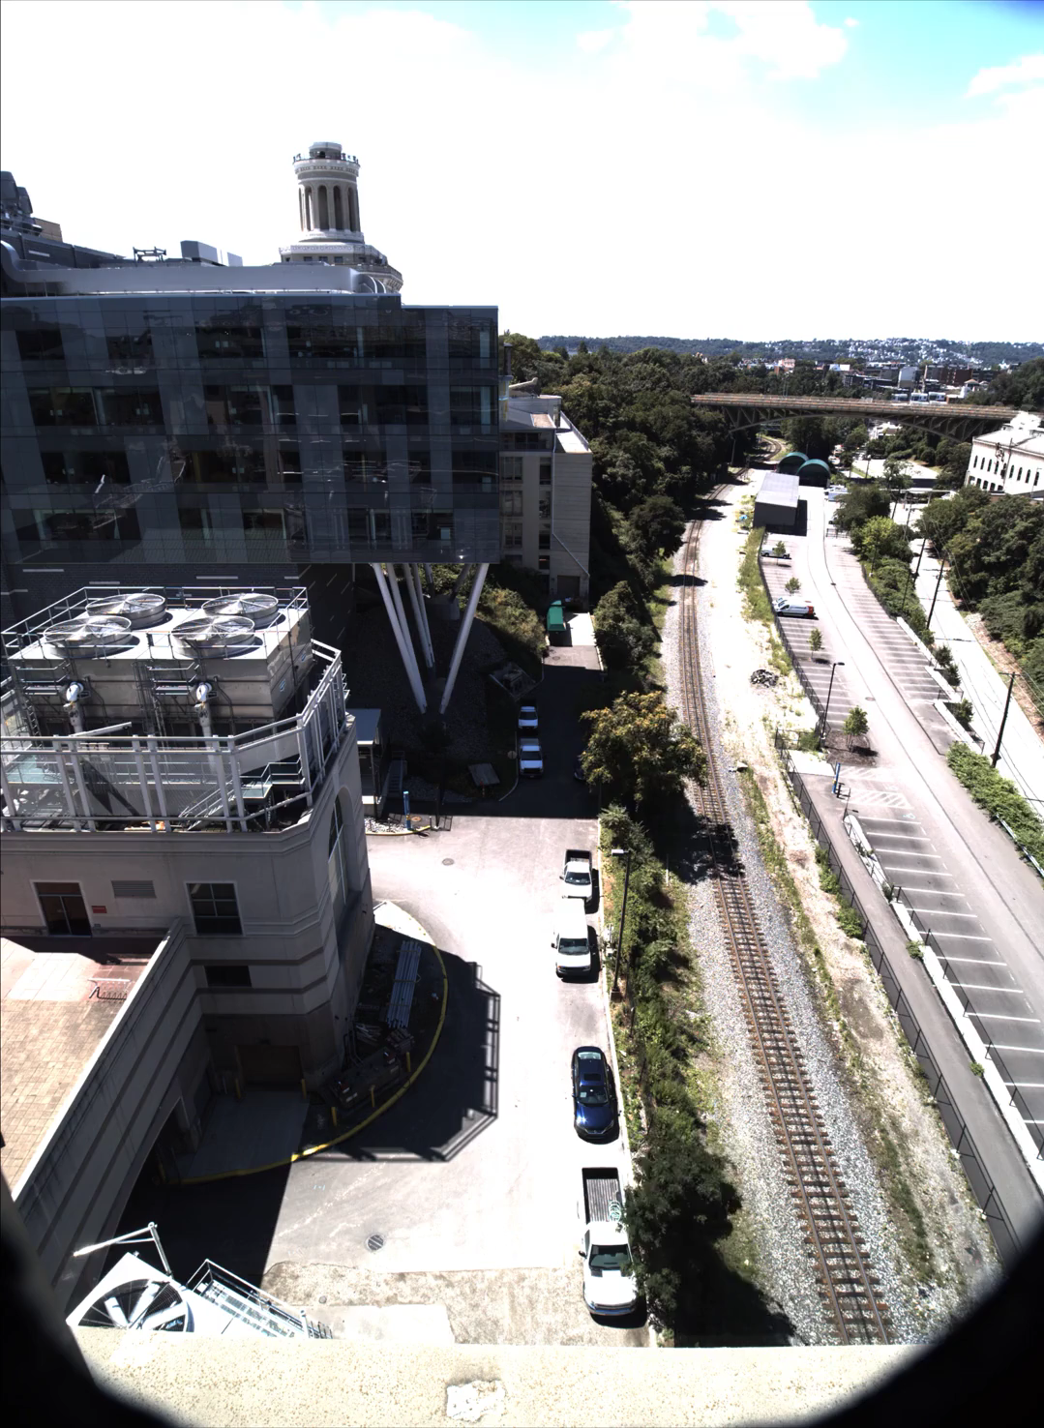
Application example:
event detection
Event F1-score depends on
accuracy or throughput
Depends on runtime conditions
Notes:
In the paper, we focus mostly on the case study of event detection. This is an example application of performing event detection. This is a video stream from the train tracks next to CMU. An example application is that we want to monitor for environmental pollution from the train which means our app needs to detect every time the front of the train comes by.
** More time on train examples: For this evaluation, we’re looking at a custom dataset where we’re looking at the intersection …**

Slide 67
Mainstream
HOW DO WE DECIDE WHAT TO FINE-TUNE?
Event Recall How many relevant events are detected?
Event Precision How many detected events are relevant?
Event F1 Score Harmonic mean between precision and recall
Notes:
The three metrics that we're going to use to measure the performance of this application are 3 common machine learning metrics. First we’ll measure the event recall which is what percentage of the events are actually detected; The precision which is out of the things that we said were trains how many were actually trains; and F1 score which is the harmonic mean between precision and recall.
The next thing we need to understand is how the model accuracy and your throughput affects your applications F1 score.

Slide 68
Mainstream
HOW DO WE DECIDE WHAT TO FINE-TUNE?
Event Recall How many relevant events are detected?
Event Precision How many detected events are relevant?
Event F1 Score Harmonic mean between precision and recall
Best configuration depends on
model accuracy and runtime FPS
Notes:
And you don’t know if that there’s similarities between with them. Did all of the red stuff twice. Base piece of our opportuniy. REd stuff doesn’t have to be done twicwe
Because the output of the red stuff is gonna be identical. Animate in merged DNNed. Number of bubbles you have to process are smaller, and if you have milions of bubbldes but hundreds of thousands of red bubbles

Slide 69
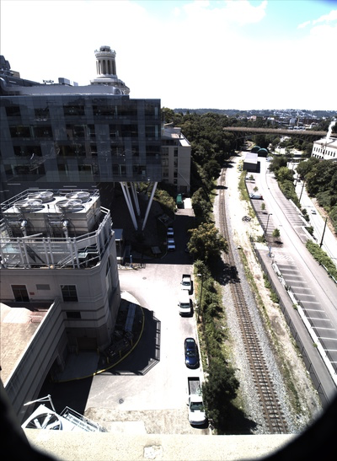
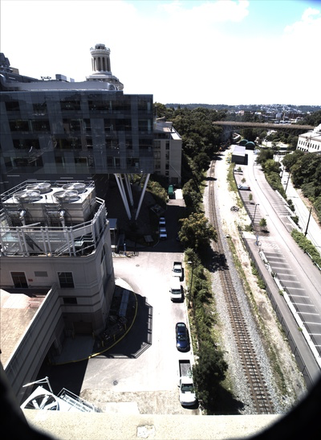
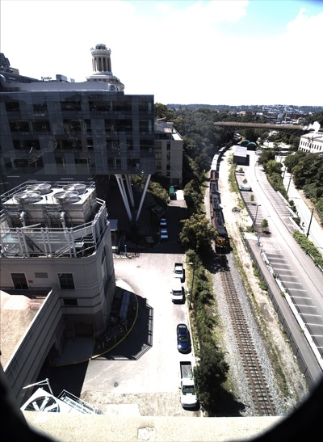
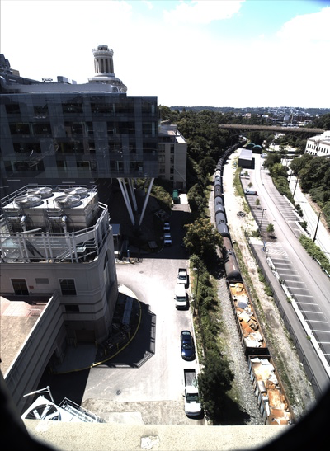
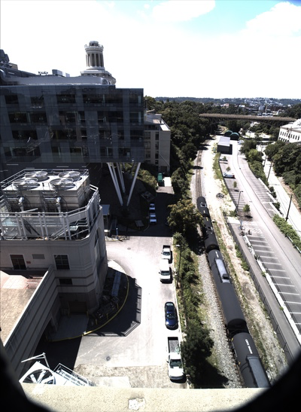
Notes:
Grey out
Hammer on *front* of the train, so needs to be one of the two

Slide 70
Goal: Classify frame with front of train
Notes:
Grey out
Hammer on *front* of the train, so needs to be one of the two

Slide 71
Low FPS can lead to missing event
Notes:
Grey out
Hammer on *front* of the train, so needs to be one of the two

Slide 72
Low FPS can lead to missing event
Notes:
Grey out
Hammer on *front* of the train, so needs to be one of the two

Slide 73
High FPS gives model MORE opportunities
Notes:
Grey out
Hammer on *front* of the train, so needs to be one of the two

Slide 74
Mainstream
How to defer the optimization to runtime?

Slide 75
Mainstream
SYSTEM ARCHITECTURE
App 1 dataset
App 2 dataset
Trainer SDK
Trainer SDK
Scheduler
Runner
Notes:
Next I’ll talk about what mainstream actually is, by going through the architecture. Mainstream consists of three components: the trainer the scheduler and the runner.

Slide 76
Mainstream
SYSTEM ARCHITECTURE: DURING DEVELOPMENT
App 1 dataset
App 2 dataset
Trainer SDK
Trainer SDK
App 1 model 1
App 1 model 1
App 1 model n
App 2 model 1
App 1 model 2
App 2 model 1
App 1 model 2
App 2 model 2
…
…
Scheduler
Notes:
** Make it clear that for each application, we need to choose one of them. Circle one of them as a choice. Change the choice when App 2 comes in **

Slide 77
Mainstream
EXPERIMENTAL SETUP
Run concurrent image classification pipelines (MobileNet-224)
Events Pedestrian, bus, red car, all-cross, school bus, train, car
Hardware Desktop-class Intel i7 8th Gen
Video stream 20 FPS, 224x224 pixels
Decode
Transform
Classify
Post-process
Notes:
Now I'll talk about how mainstream performs against some default static approaches. What we're going to do here is we're going to run concurrent image classification pipelines like the ones I showed earlier.The pipelines are going to detecting one of seven events so they're going to detect if there is a pedestrian in scene, a bus in the scene, a red car, etc.
** introduce custom dataset if not already **

Slide 78
Mainstream
Max Sharing [Han17]
No Sharing
Notes:
The two static approaches that we’ll compare against is max sharing and no sharing, both of which are common default approaches.

Slide 79
Mainstream
MAINSTREAM OUTPERFORMS STATIC METHODS
Notes:
On the X-axis, we're increasing the number of concurrent applications up to 25. And on the y-axis we're showing the average event F1 score across the applications and higher is better. In the red we have mainstream, in the Blue, Max sharing and in the green, no sharing.

Slide 80
Mainstream
MAINSTREAM OUTPERFORMS STATIC METHODS
Frame relative
accuracy: 1.0
0.36 FPS
Notes:
No sharing has the benefit of never having to sacrifice model accuracy. But as you add applications, the throughput degrades really quickly and you start missing frames.

Slide 81
Mainstream
MAINSTREAM OUTPERFORMS STATIC METHODS
Frame relative
accuracy: 0.6
6.8 FPS
Notes:
With max sharing, we have the opposite problem. It's a very scalable approach and we’re able to retain a very high throughput even with a large number of applications. But we held so much of the network Frozen during training time that the models aren't very good.

Slide 82
Mainstream
MAINSTREAM OUTPERFORMS STATIC METHODS
Frame relative
accuracy: 0.96
5.9 FPS
Notes:
Mainstream is a mix of both so sometimes it just decides to sacrifice a little bit of accuracy; sometimes it sacrifices a little bit of throughput, always in a way that maximally utilizes resources. An important takeaway of the results is that mainstream in almost all cases will greatly outperform a static approach. Compared to these two static approaches, there's two scenarios where it will perform the same. If you have one application, Mainstream will perform the same as no sharing. And if you have a very large amount of applications where your resources are saturated, Mainstream will perform the same as Max sharing. In between is where we have the benefit of performing the optimization.

Slide 83
Mainstream
TAKEAWAYS
Adaptively tunes degree of specialization at runtime
✓
Based on resources available and deployed apps
Mainstream outperforms default static approaches
✓
Up to 87x improvement in F1 score compared to no sharing
Up to 47% improvement compared to max sharing
www.github.com/angelajiang/mainstream
Notes:
In conclusion, I talked about how mainstream is able to provide a scalable multi-tenant deployment of concurrent video analysis applications. We do this by optimizing for DNN computation sharing and we defer this optimization to runtime so that we can adapt to the resources available and the set of deployed applications. As a result we see that mainstream greatly outperforms default static approaches while never performing worse.

Slide 84
Conclusion
SUMMARY OF FINDINGS
Using runtime information to dynamically adapt hyperparameters that are traditionally static can increase the accuracy and speed of ML training and inference.
Dynamic emphasis on individual training examples trains up to 3.5x faster than static approaches.
Dynamic determination of weights updated during transfer learning, leads to 47% and 87x higher F1-score compared to static approaches.
github.com/angelajiang/SelectiveBackprop
github.com/angelajiang/mainstream

Slide 85
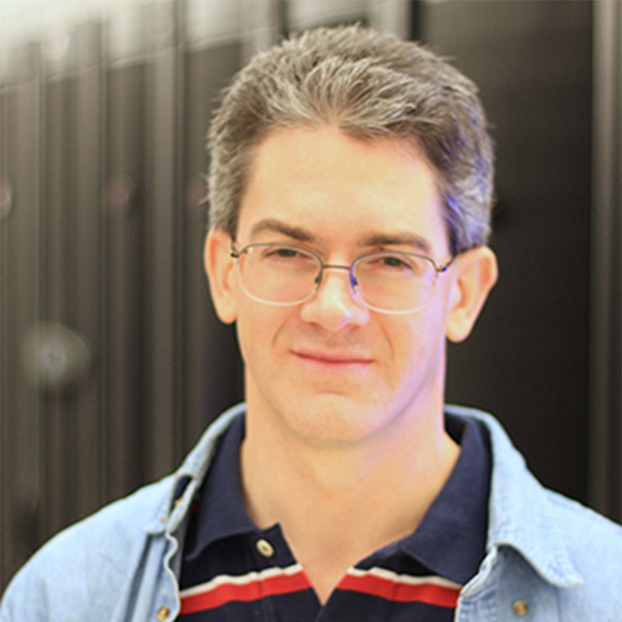
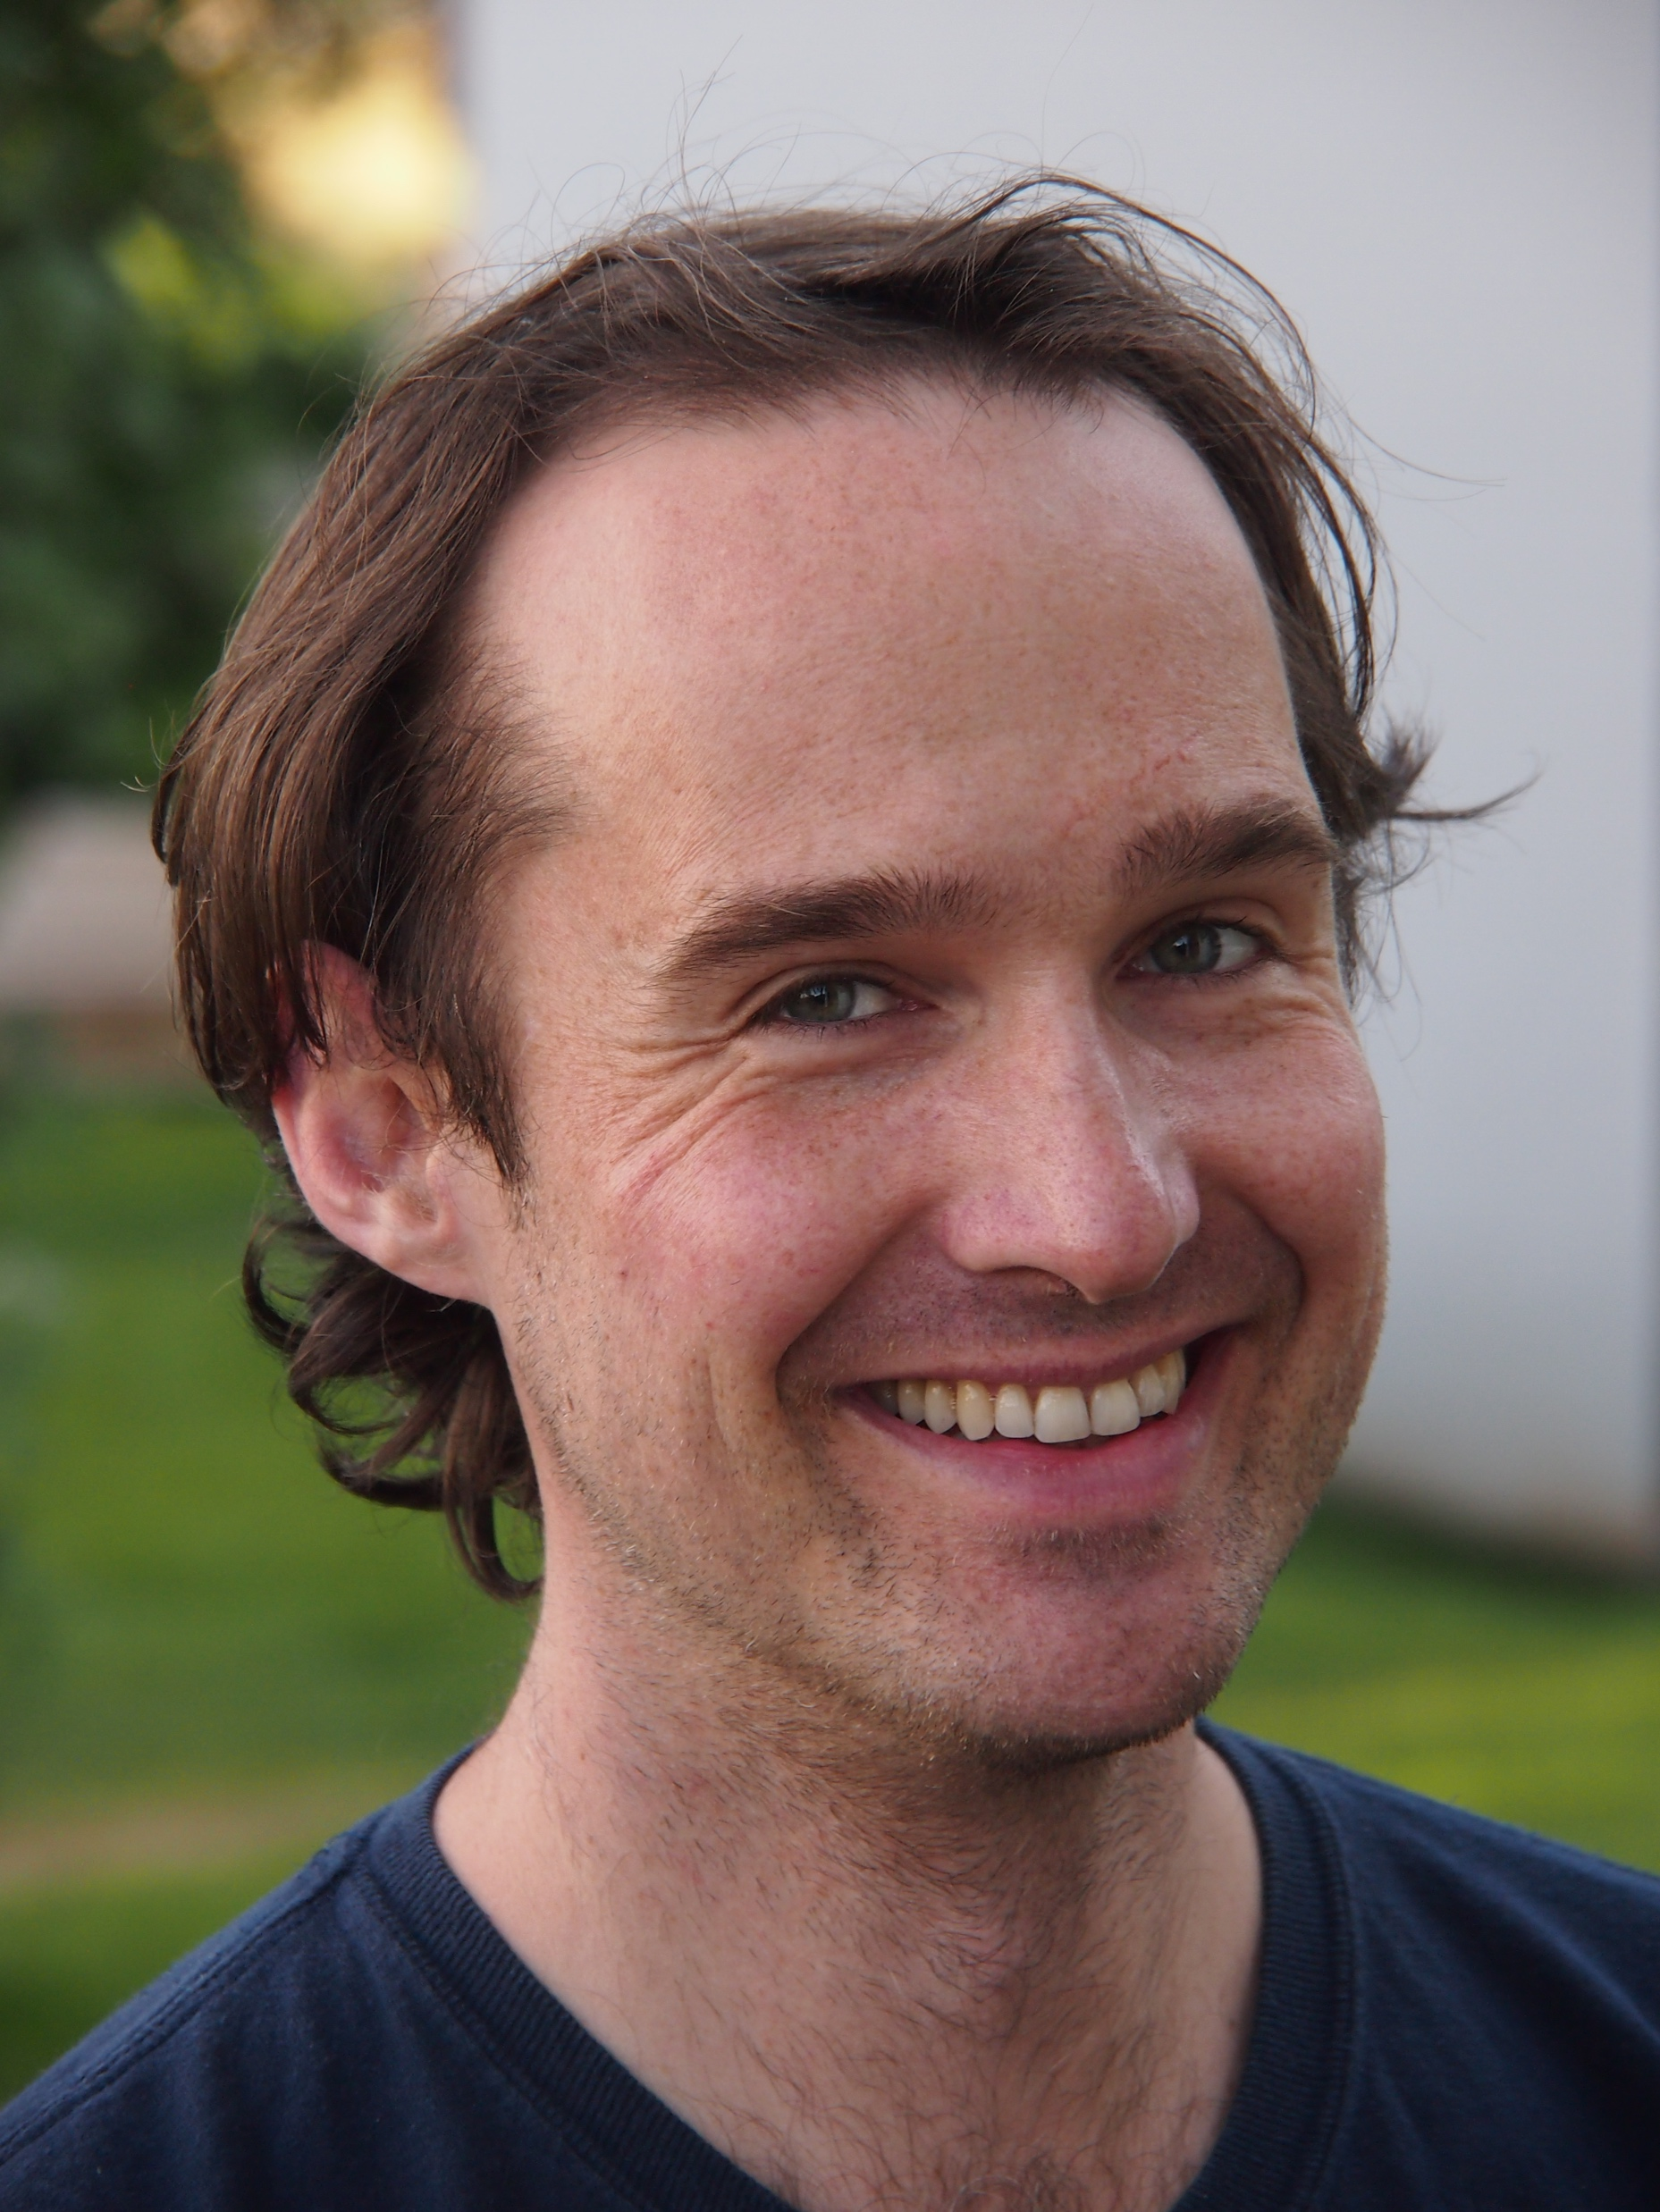
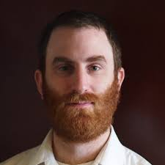
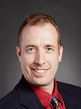
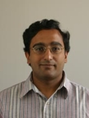
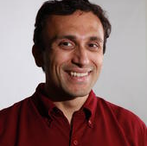
Acknowledgements
THESIS COMMITTEE
Notes:
** Thank you to my thesis committee for all your help and advice along the way **
** Names **

Slide 86
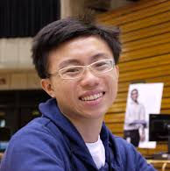

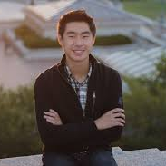
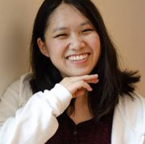
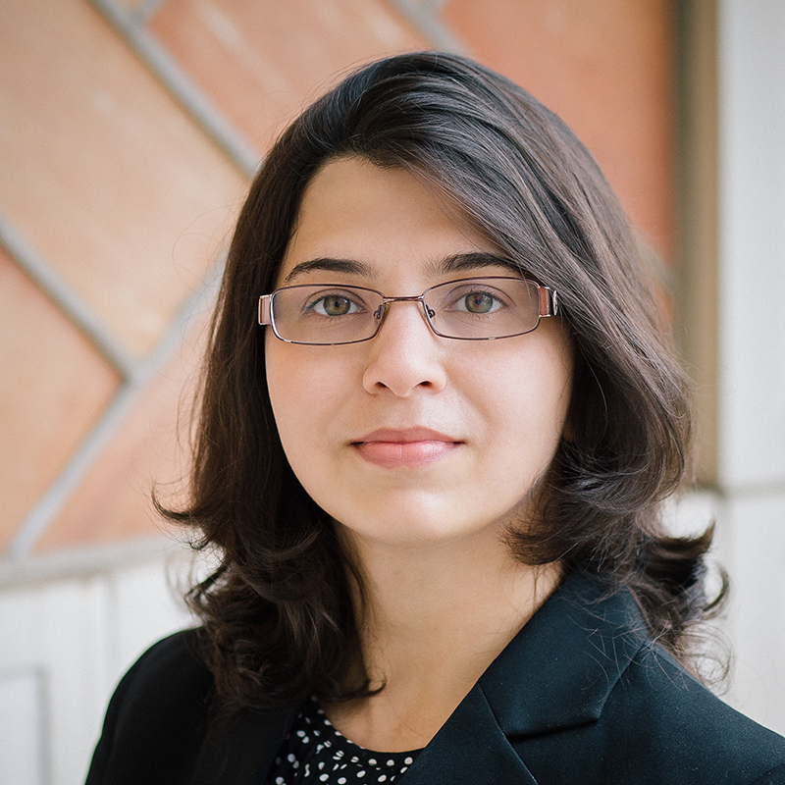
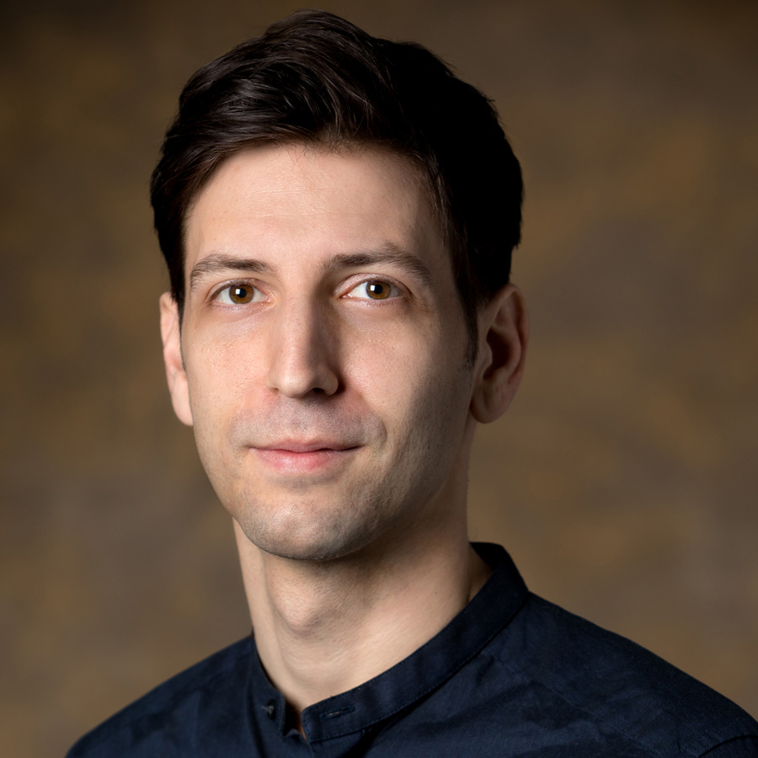
Acknowledgements
SOME OTHER COLLABORATORS
Notes:
** In addition to my committee, I’d like to thank my other collaborators without whom I wouldn’t have been able to accomplish this work **

Slide 87
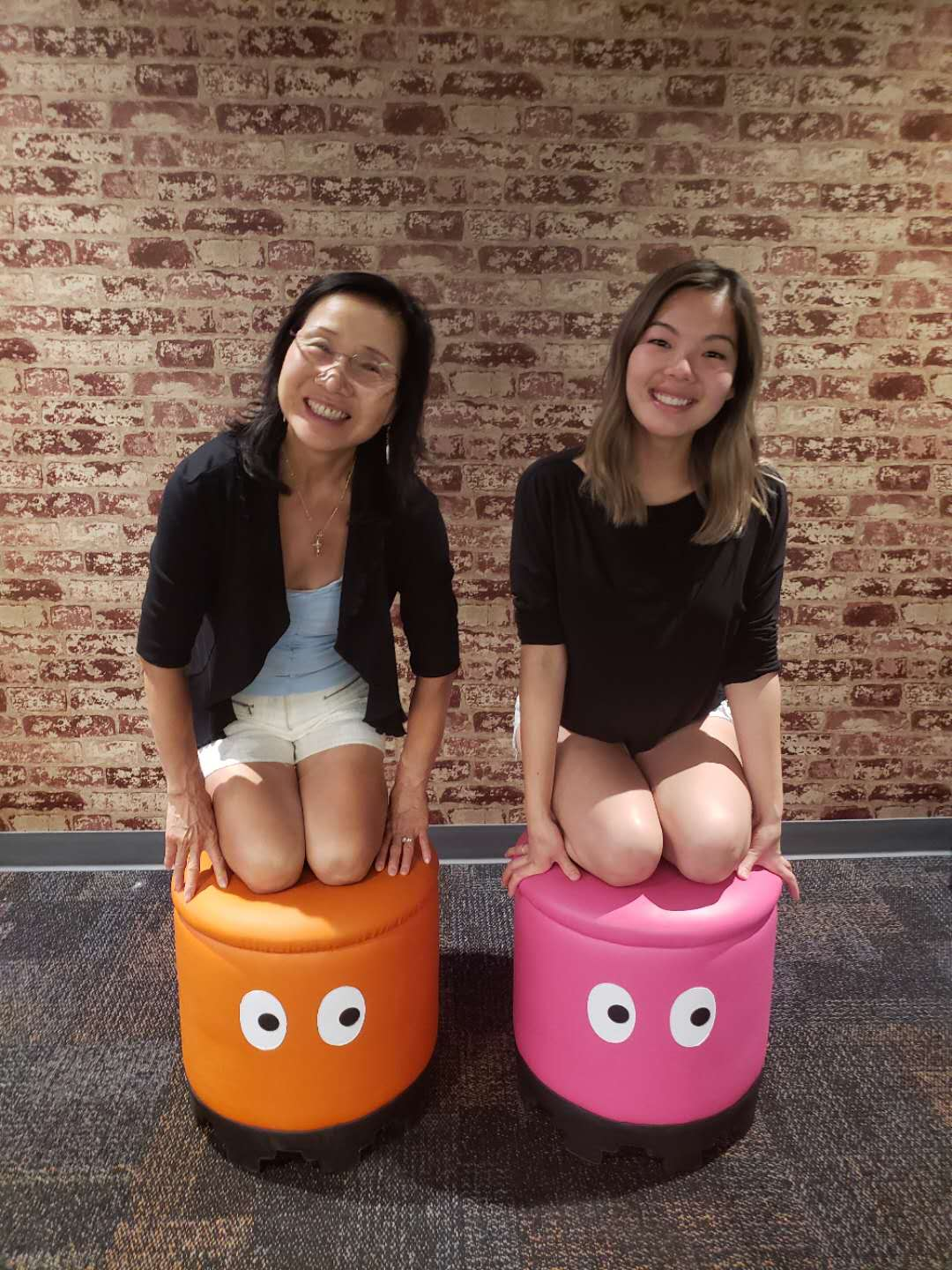
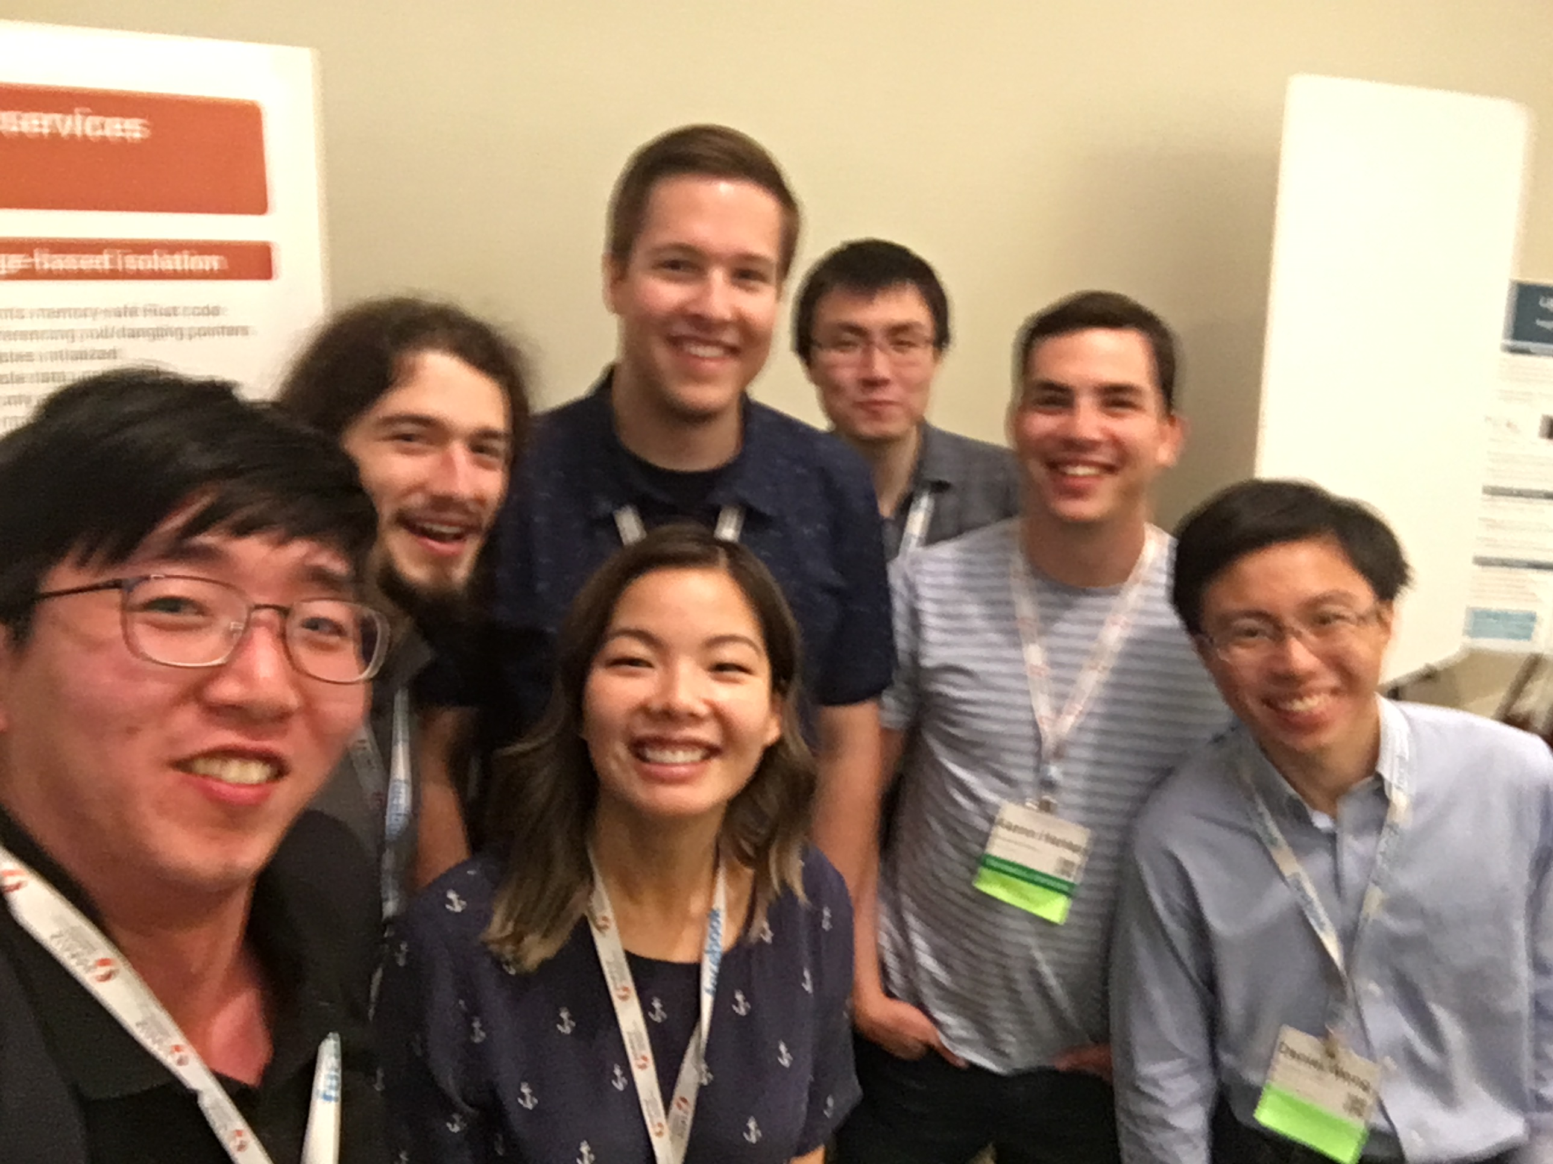
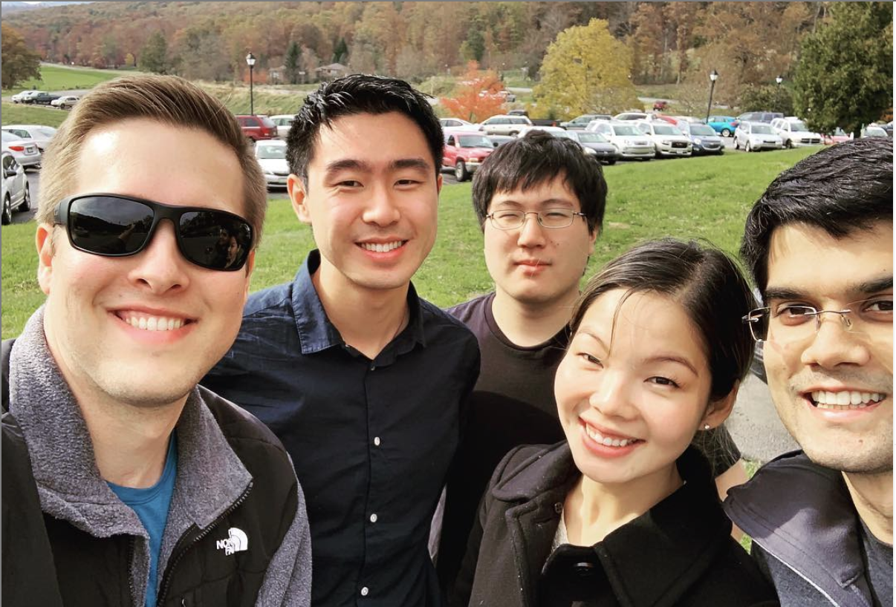
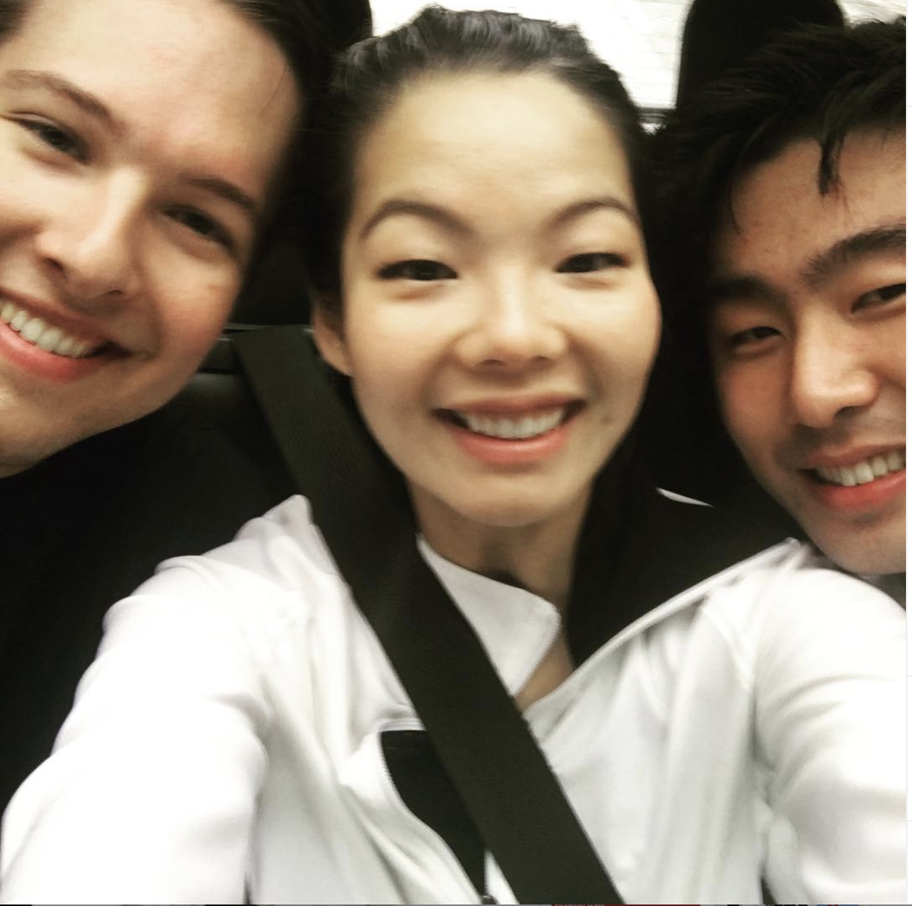
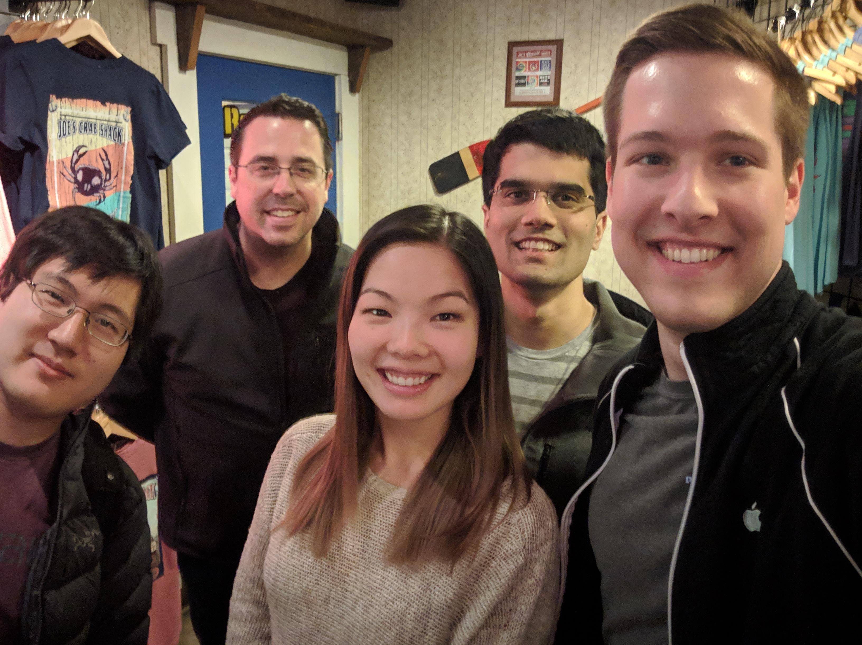
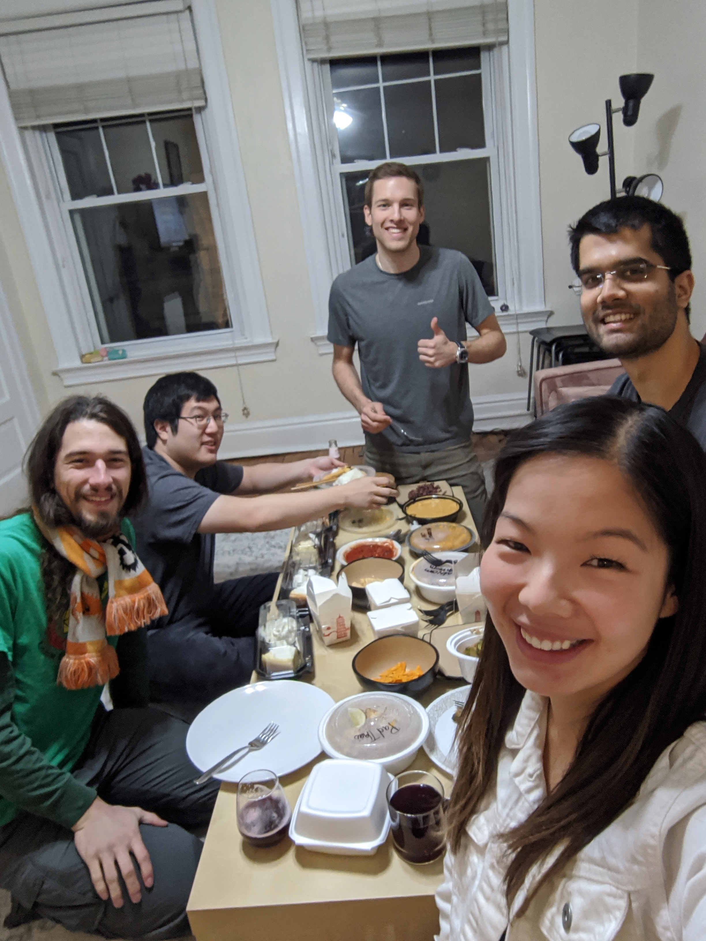
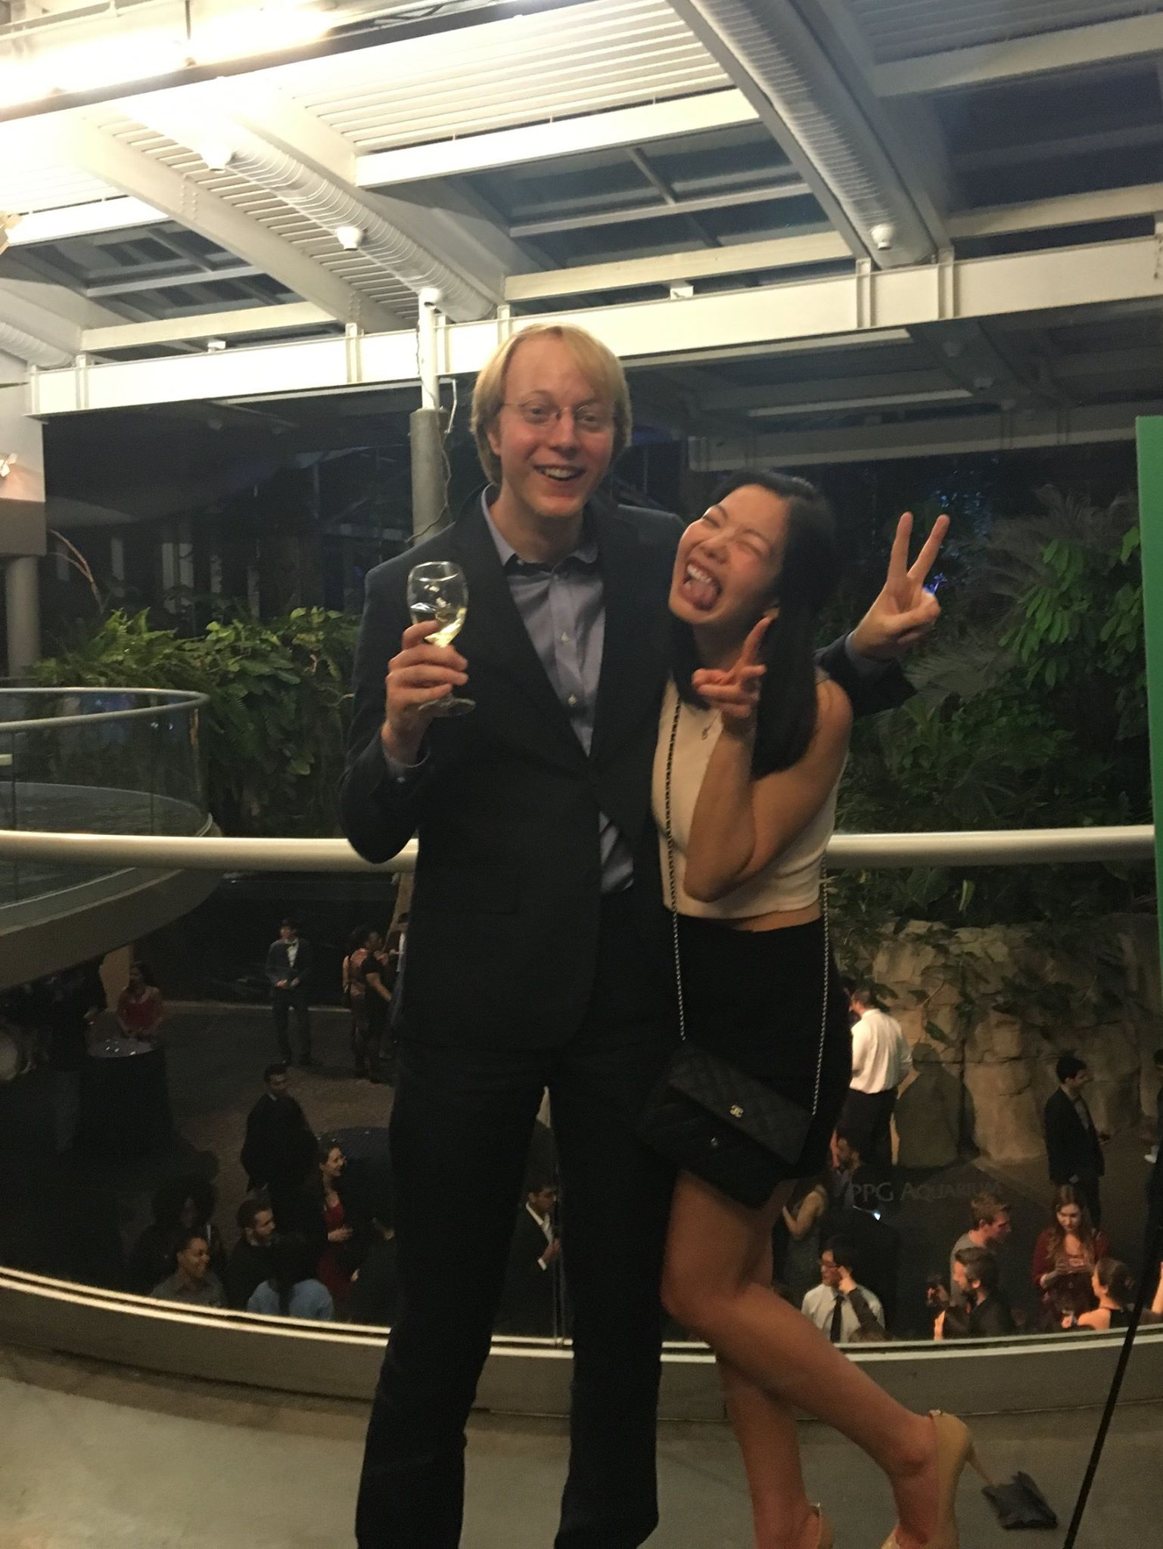
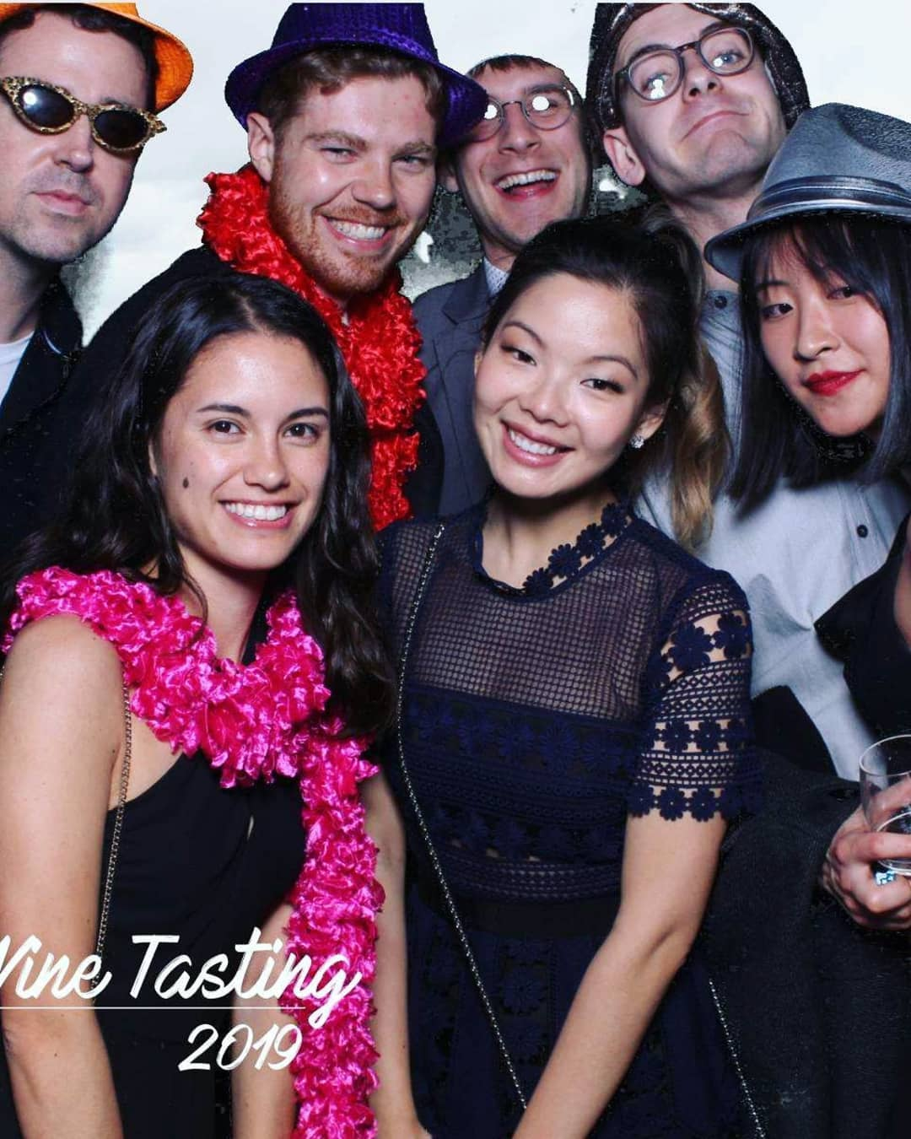
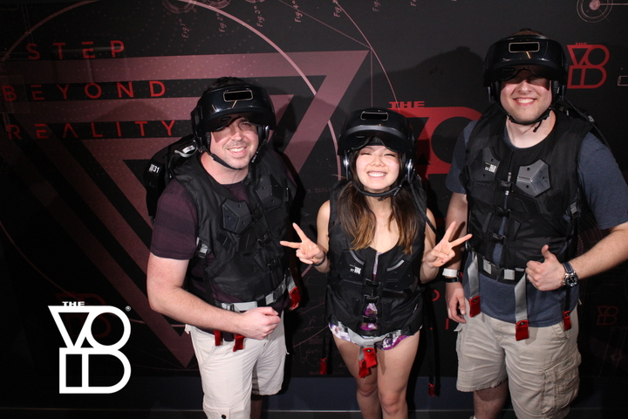
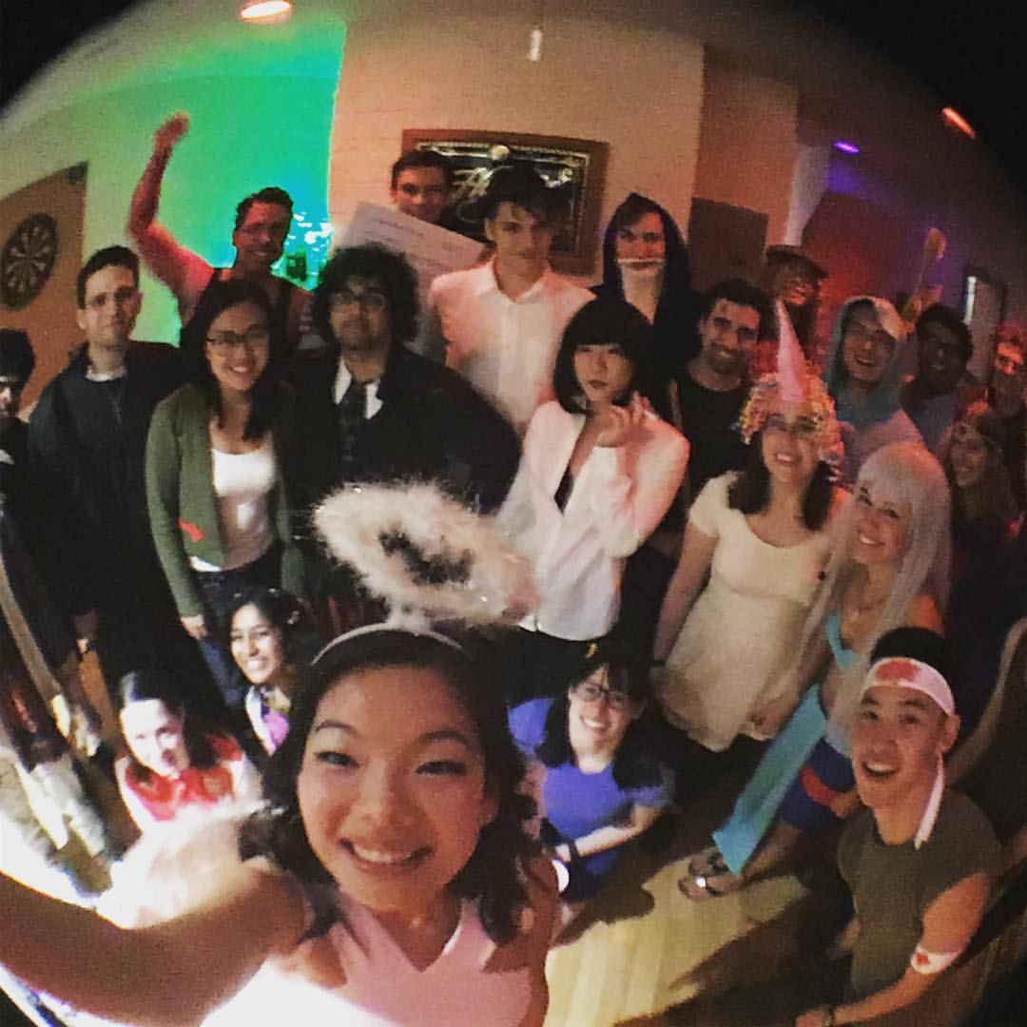
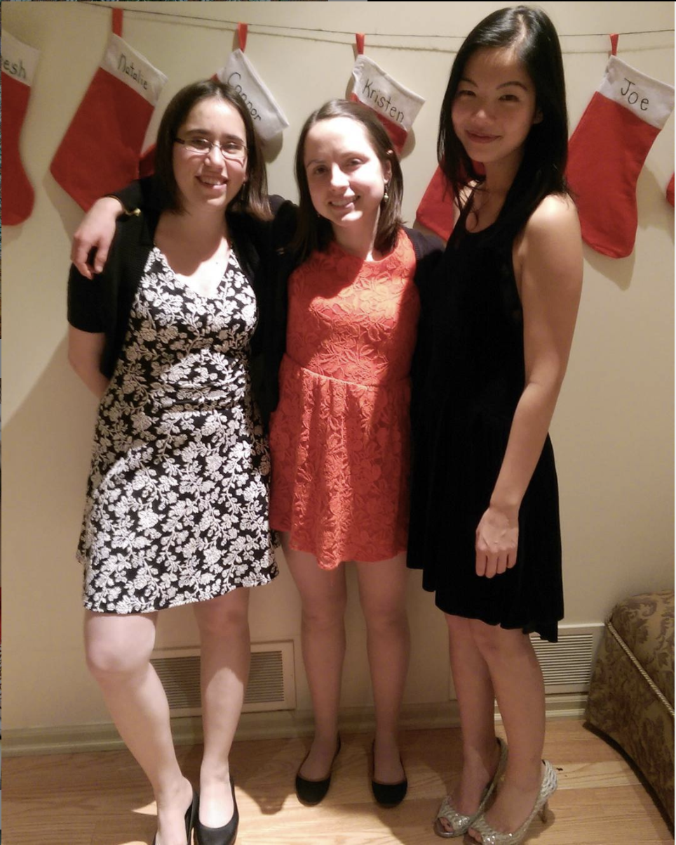
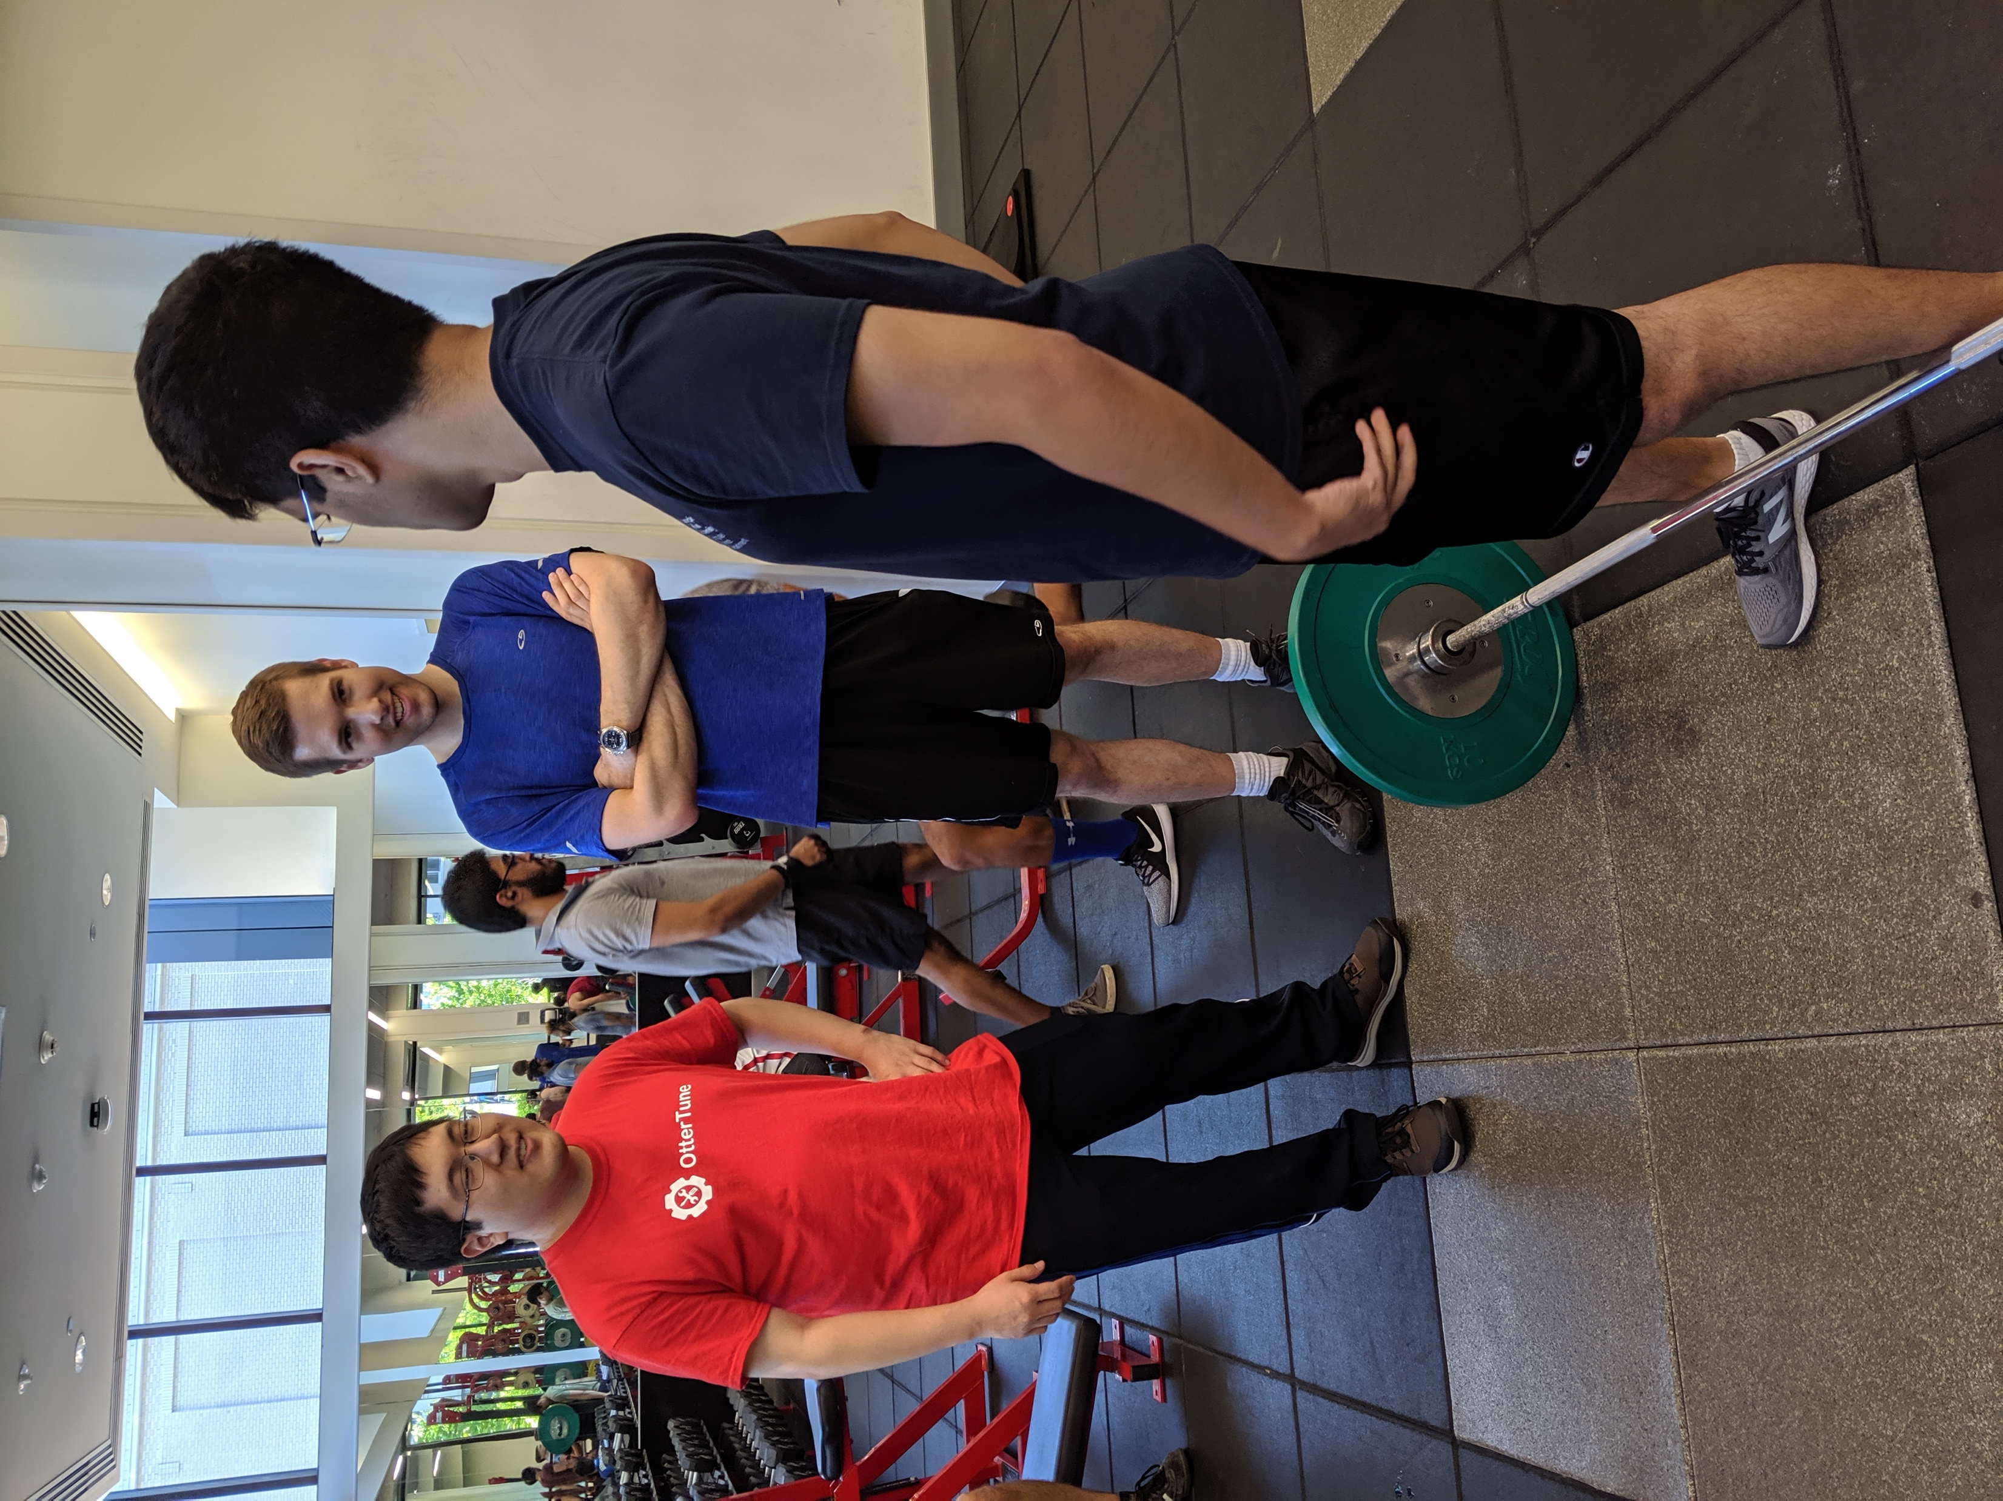
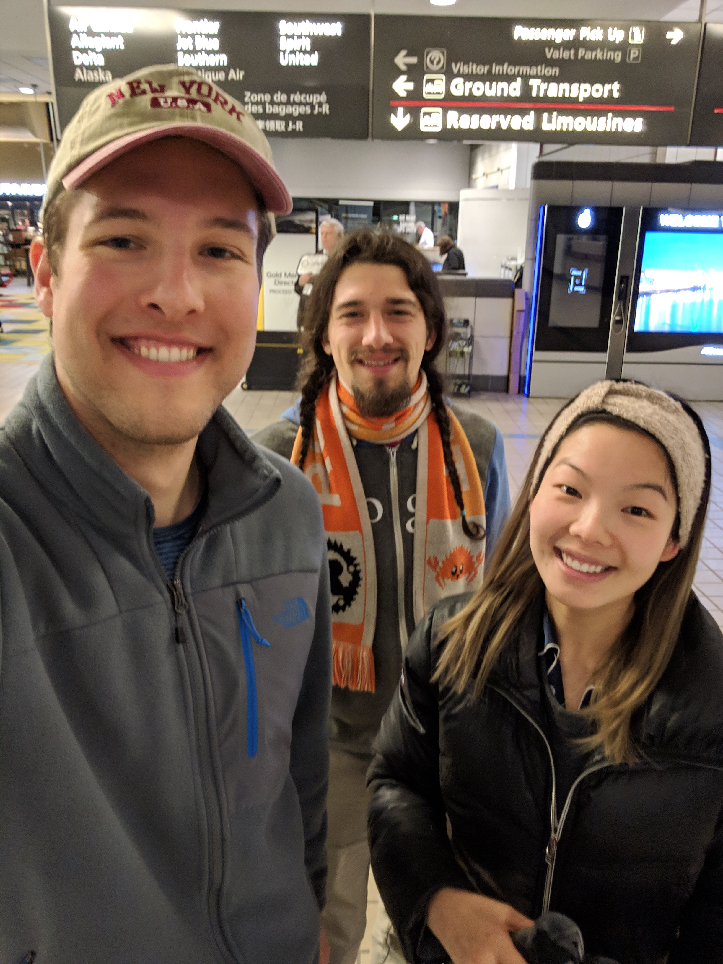
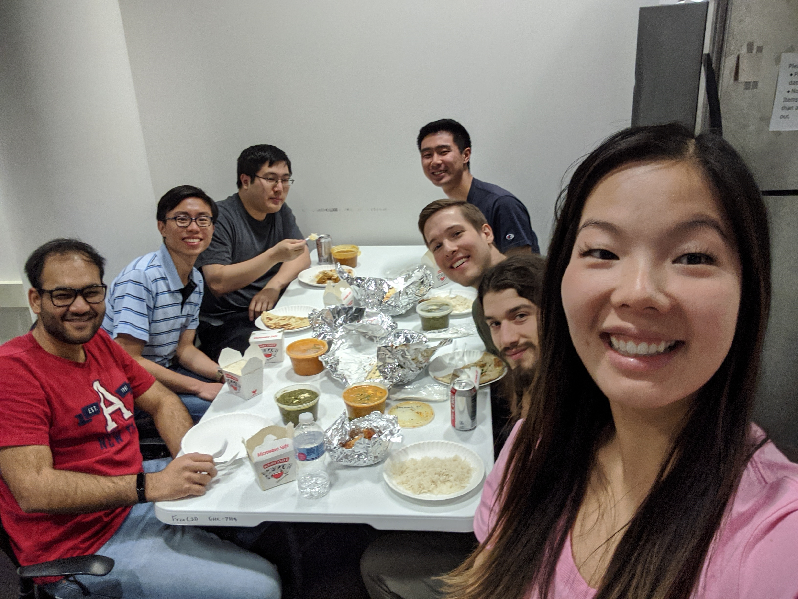
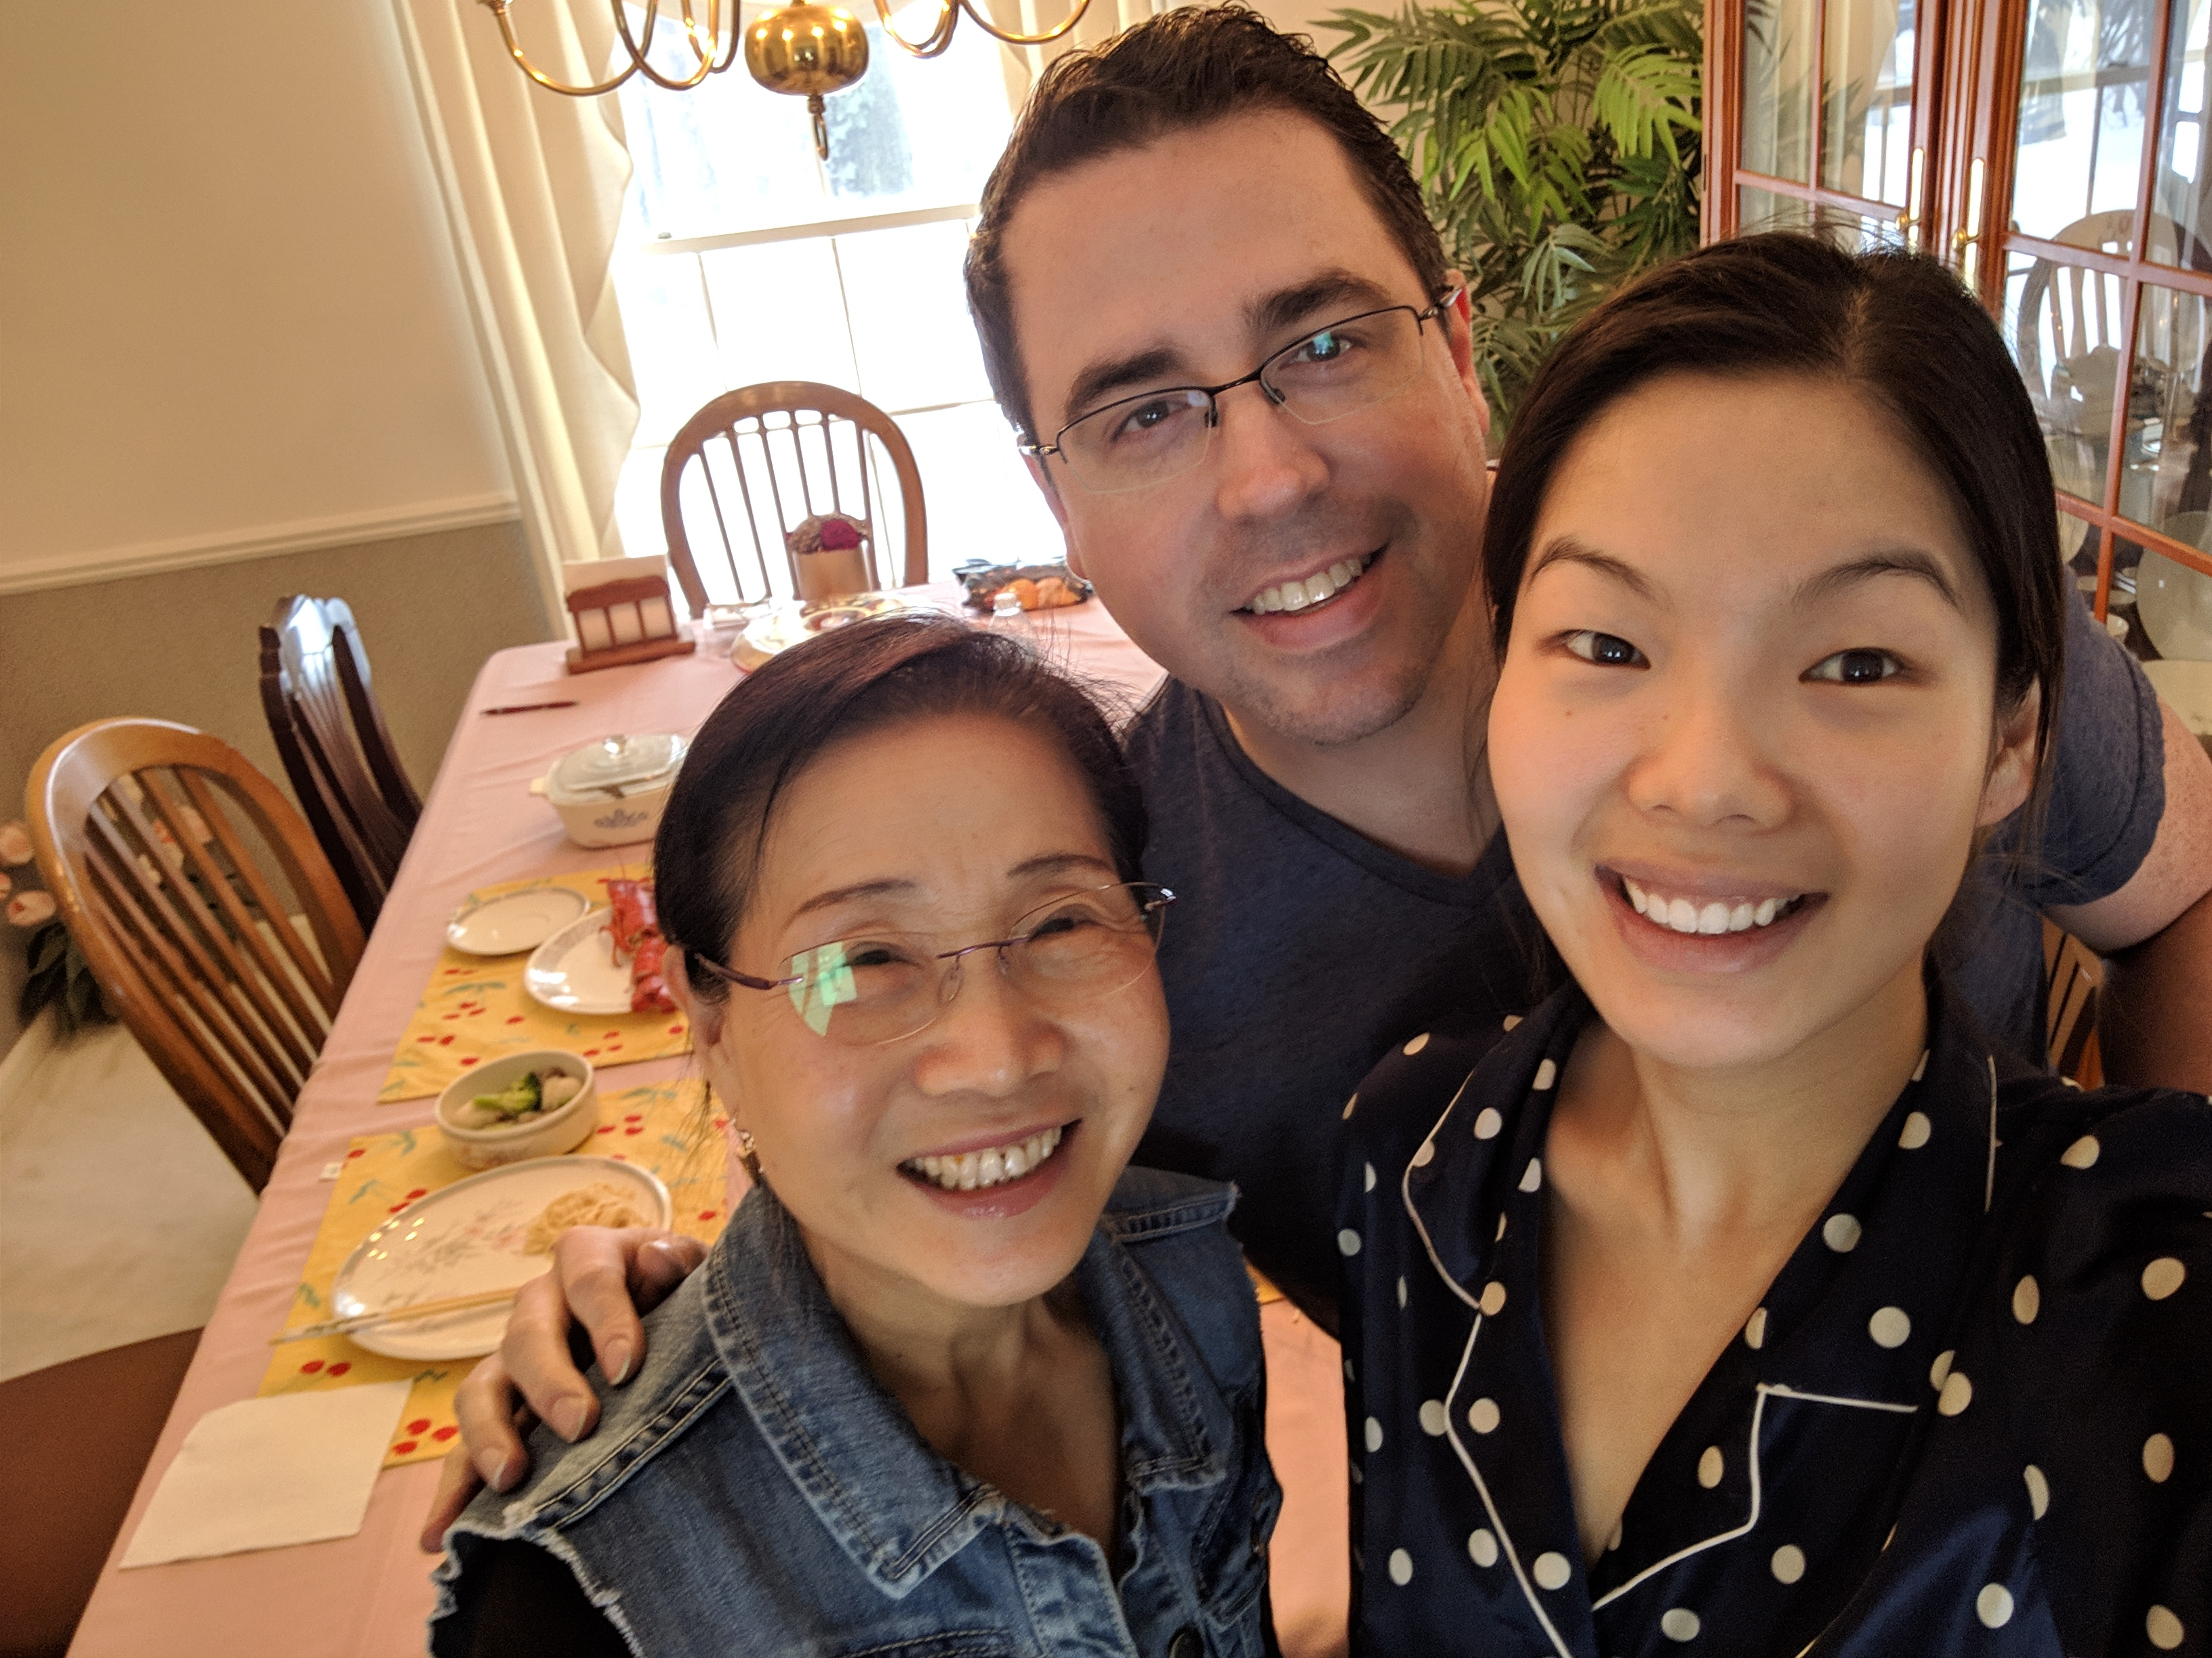
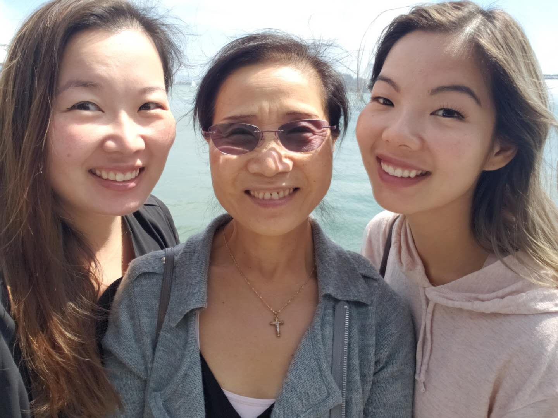

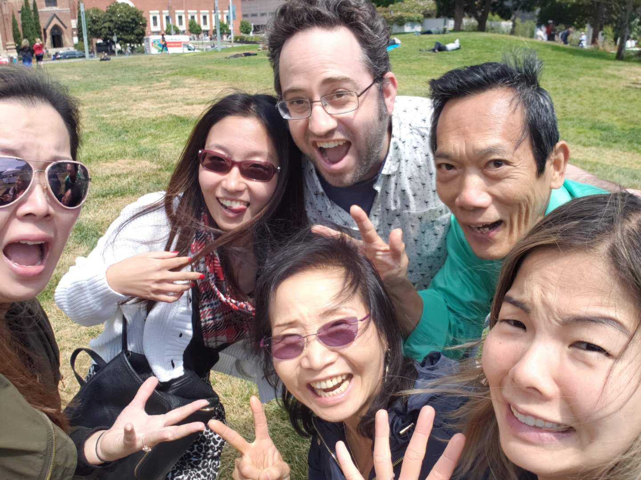
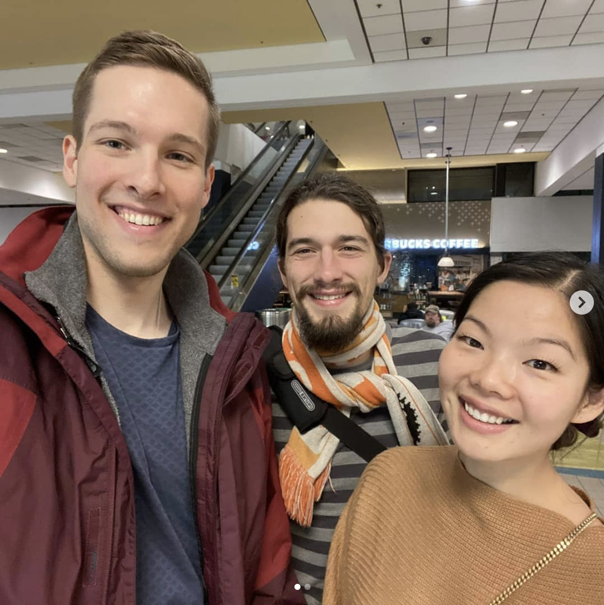


Slide 88
Conclusion
SUMMARY OF FINDINGS
Using runtime information to dynamically adapt hyperparameters that are traditionally static can increase the accuracy and speed of ML training and inference.
Dynamic emphasis on individual training examples accelerates training by up to 3.5x compared to static sampling approaches.
Dynamic determination of weights updated during transfer learning, leads to 47% and 87x higher F1-score compared to static approaches.
github.com/angelajiang/SelectiveBackprop
github.com/angelajiang/mainstream

Slide 89
SelectiveBackprop
COMPARED APPROACHES
Traditional
Classic SGD with no filtering
Katharopoulos18
State of the art importance sampling approach
Random
Random sampling approach
Selective-Backprop (Us)
Notes:
In the real world, we don't know what accuracy we can get to, but we may have a fixed amout of time. Most of the time you'll do better this way. super optimized, run forever kind of things to get the best state of the art accuracy. A lot of times you don't know what the accuracy's gonna be. You're gonna care about it a little less
Remove this whole slide

Slide 90
SelectiveBackprop
SVHN
Given 40 hours to train,
StaleSB provides lowest error
Notes:
CIFAR10: 72%
SVHN: 80%

Slide 91
SelectiveBackprop
MOST PARETO OPTIMAL POINTS ARE SB OR STALE-SB
Given unlimited time to train,
Traditional provides lowest error
Notes:
CIFAR10: 72%
SVHN: 80%

Slide 92
SelectiveBackprop
STALE-SB REDUCES FORWARD PASSES
Notes:
SB: 1.5x
StaleSB: 2.0x
2.96%

